Slide 1
Applied Photonics in Amateur Astronomy
Presented to the Rockford Amateur Astronomy Club
Liam Plybon
Sept 18, 2021
Notes:
Howdy, My name is Liam and today I will be presenting about the use of Photonics in Astronomy, and how it can be leveraged, even by amateurs, to improve their images and artistic or scientific results.

Slide 2
Particle Detector Update
Notes:
First, I will be giving a quick update to the subject of my last talk in February, where I described a DIY muon telescope and showed one of my new builds.

Slide 3
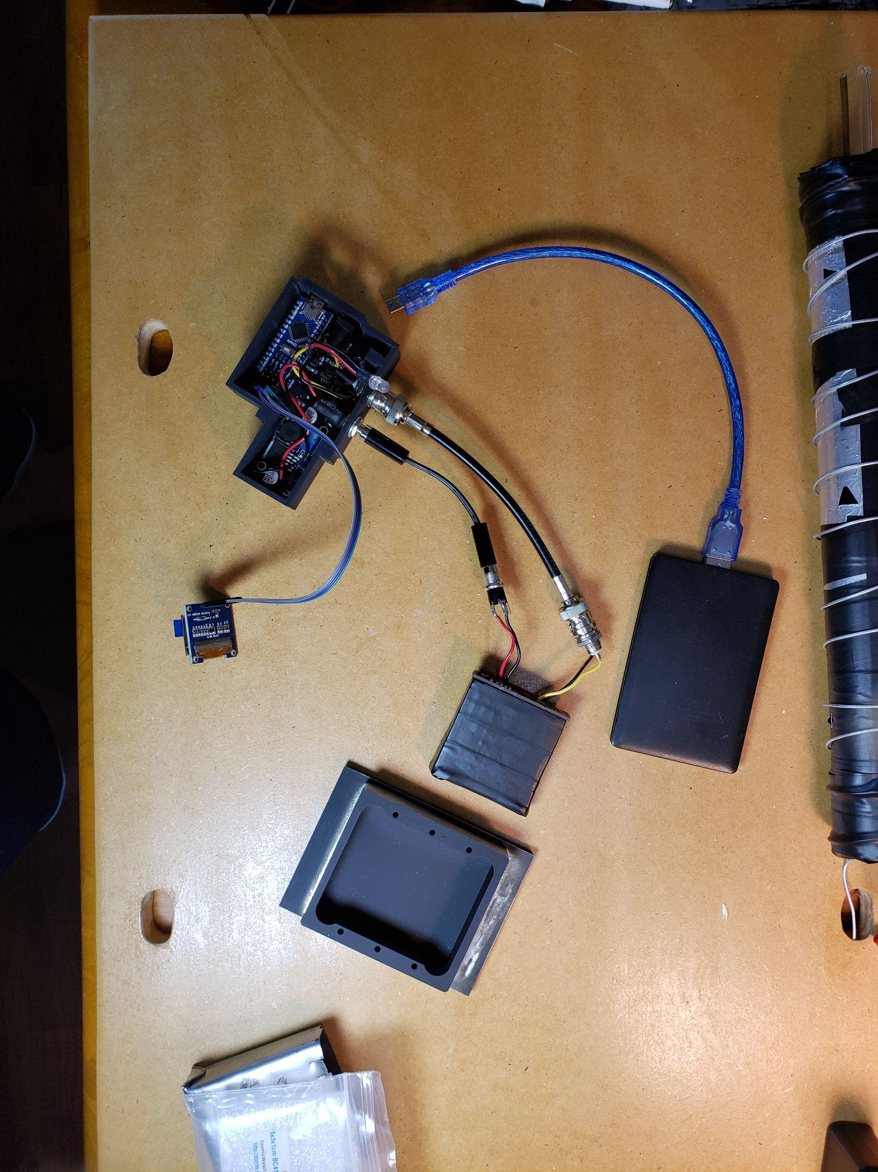
DIY Muon Detector
Identify cosmic rays through muon detections.
Small scintillator paddle that pulses when particles pass through.
Combine two paddles to make a ‘telescope’.
Detect cosmic rays and perform particle astronomy!
Notes:
For those who missed the presentation and have no idea what I am talking about, in February I presented a DIY particle detector for identifying cosmic rays. The project was based on work done by Spencer Araxani, who came up with the CosmicWatch detector. It’s a pretty neat project, with some room for improvement. The build only cost me about 400 dollars, which is way more than I initially budgeted, but that has more to do with me burning out components during testing and assembly than anything else. Ideally, this build should cost less than 100 dollars.

Slide 4
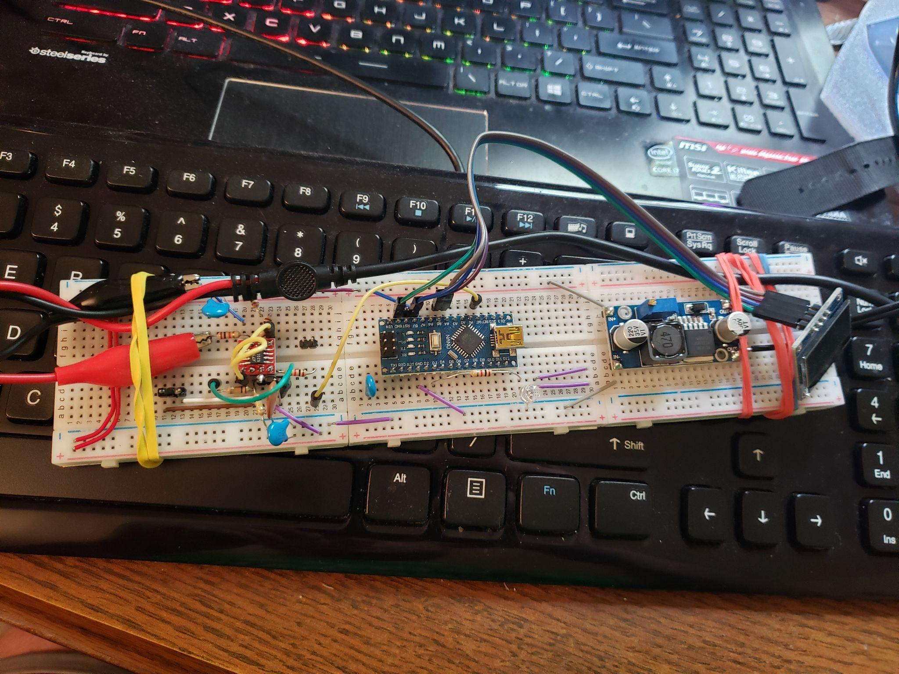
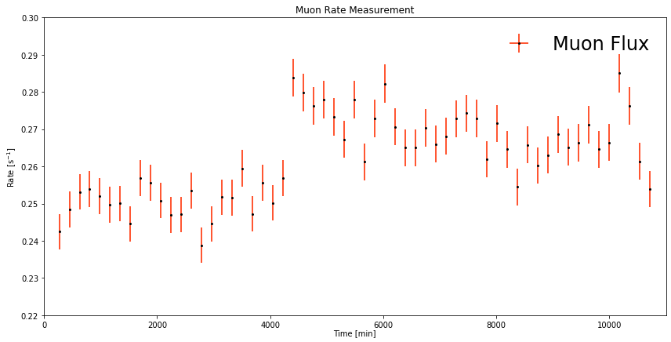
Paddle 1 Complete
Tested and working!
Took data over a few weeks for initial test
Took 1 month run for verification, still need to analyze data
Found improvements for a future design, like auto-triggering with an internal LED and using an IOT network to connect multiple detectors.
Notes:
The detector paddle I built works, and I have been running it through some tests. Ultimately, the boards that I had made didn’t work as well as I had hoped. Eventually, I built the detector out on a breadboard to debug the issues, most of which had to do with component values. I ran a week long test of the detector and analyzed the data, giving me some important ideas on the sensitivity of the detector and easy ways to ruin my collection runs by accident. First, having to open the light tight enclosure each time I wanted to manually excite the detector was a real pain. Instead, I want to use an LED or other electronic light that can pulse the detector, built into the detector itself. Next, I want to experiment with an IoT approach and make a detector cluster, like ICECUBE or other large scale neutrino observatories.

Slide 5
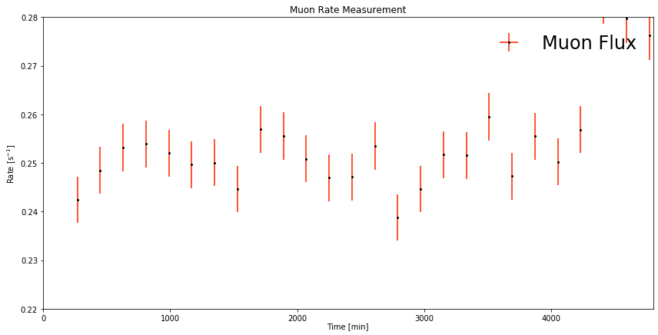
Notes:
Here is the cleanest data set from the first run of the detector, covering three days of runtime. Time is on the x axis, and count rate is on the y axis, with each data point representing a three hour ‘exposure’. The day night cycle is easily apparent in the first day, and is still identifiable in the following two days. At the end of the chart, the count rate goes up significantly due to me moving the detector 5 inches closer to the wall, after which point background flux rises. The detector was very sensitive to motion and relocation, so future runs will have to be protected from unintended human interruption and family members.

Slide 6
Applied Photonics?
Notes:
With that out of the way, I’ll start the planned talk. First, I want to describe what I mean by Applied Photonics. This field is very young, and is extremely fascinating. Then, I’ll show some ways that we as amateur astronomers can (and already do) make use of this innovative branch of technology.

Slide 7
The intersection of light and electronics!
Lasers
Fiber Optics
Microlenses
Advanced Glasses and Ceramics
Photonic Chips and Integrated Circuits
Super-Resolution Algorithms
IImage: Christophe.Finot
Notes:
Photonics is the study of light manipulation not simply as a ray, like in classical optics, but as understood in the context of modern physics. Single mode fiber optics, lasers, photonic chips, and spectrometers are all considered to fall under the study of photonics. Light sensors like CCD and CMOS cameras would be impossible without this important field of physics. Here I have listed a few different applications of photonics, which may or may not be familiar to you.

Slide 8
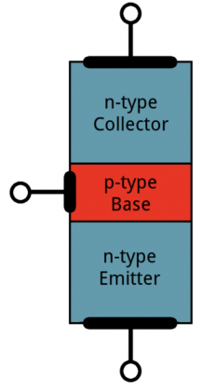
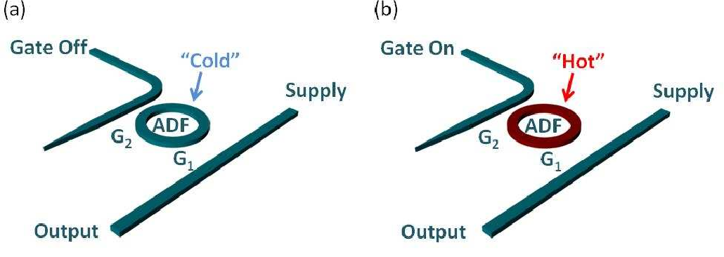
Photonic Transistors, Filters and Computers
Image: Sparkfun.com
Electronic (top right) vs Photonic (bottom)
arXiv:1204.5515
Notes:
One of the most interesting near-future applications of photonics is the concept of an optical computer, where photons, rather than electrons, are the signal carriers. While this would make computers faster, the most desirable aspect of a photonic computer is the reduced power consumption. Light requires less energy to trigger a photonic transistor, or carry through a fiber optic cable, than electrons do. As such, the computer wouldn’t get nearly as hot, which is the biggest bottleneck in large computers and server farms today.
In this optical transistor, three unique and isolated waveguides meet; a gate waveguide and supply waveguide act as the inputs, and a ring resonator waveguide is controlled through the two inputs. The output of the transistor will reflect this with a 20dB change in throughput!

Slide 9
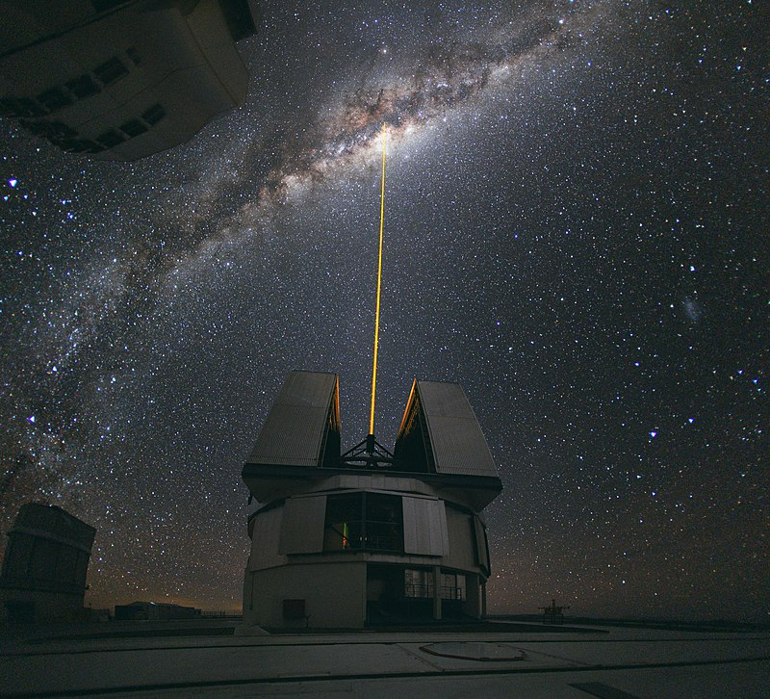
Astronomy and Photonics
Adaptive Optics
Spectrometers on Chips
Better Image Resolution (Super Resolution)
Fiber Optic Multi-Object Spectrometer Masks
Microlenses and Optical Waveguides
Image: ESO/Yuri Beletsky (ybialets at eso.org) - This media was produced by the European Southern Observatory (ESO), under the identifier potw1036aThis tag does not indicate the copyright status of the attached work. A normal copyright tag is still required. See Commons:Licensing., CC BY 4.0, https://commons.wikimedia.org/w/index.php?curid=71452798
Notes:
For astronomers, there are a number of important applications for photonics. Some of these applications are already evident in the most cutting edge observatories. Adaptive optics have become critical infrastructure for ground based large telescopes like Keck and GMT. Last year, a cubesat launched to orbit with a spectrometer on a chip, capable of taking spectral data on specific wavelengths with sub nanometer bandwidth with far less volume impact than a standard grating spectrometer, using millimeters rather than centimeters in scale. Image stacking and wavelet combination is considered a super-resolution imaging algorithm. At the Hobby Eberly Telescope, fiber optics are used in the VIRUS spectrograph in place of a slit mask to keep light from bleeding between spectrometers. All over the world, photonics is at the cutting edge of astronomy.

Slide 10
What about us?
Notes:
After listing all of these important uses of photonics technology, it’s time I get to the point. How do we, as independent, amateur astronomers, leverage technology like this? It seems far out, but is actually quite accessible.

Slide 11
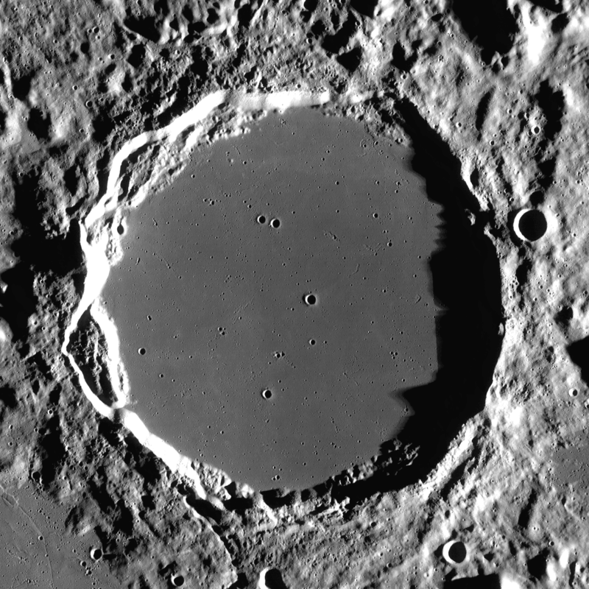
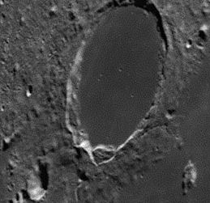
Enter Super-Resolution Algorithms.
Identical Lunar Reconnaissance Orbiter image for reference
Before Linked Wavelets
After Linked Wavelets
Images used with permission from astronomie.be/registax/
Notes:
One that we are all used to using is stacking and wavelet processing, members of a family called super-resolution algorithms. They’re used in registax and ImageJ for pulling the highest detail possible out of raw data, and are regularly used already by the amateure astronomer. Here is an image comparison of a 300 frame stack before and after wavelet analysis in Registax. You can see that details are pulled from the image that you wouldn’t have even imagined; this is Plato crater, for reference.

Slide 12
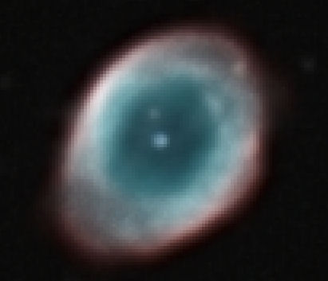
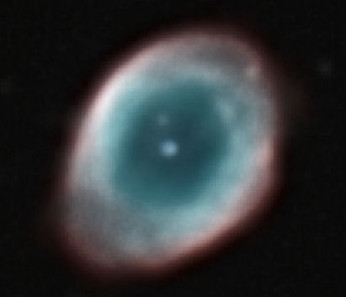
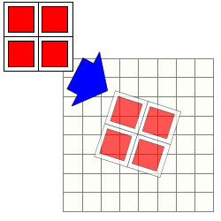
Drizzle Processing (Variable Pixel Linear Reconstruction)
No Drizzle
Drizzle x2
All images from DeepSkyStacker.com, used with permission.
Notes:
An older, but useful technique, is drizzle processing. Developed for the Hubble mission, Drizzle processing doubles or triples the pixel count of each image, then performs a stack. Doing this can bring out more resolution, and smooth out blocky looking images. Since the drizzle process happens during stacking, Wavelet processing can be done after a drizzle to bring out even more resolution. DeepSkyStacker has an easy to use Drizzle feature. Both of these algorithms can be used regardless of the instrument, which is pretty convenient for amateur astronomers who use all kinds of telescopes and cameras, and they can improve images taken on even the cheapest of equipment. The algorithms are available completely free on top of that.
Computers can only improve an image so much before you run into the fundamental limits of your optics. Further improvements with photonics require a bit of hardware!

Slide 13
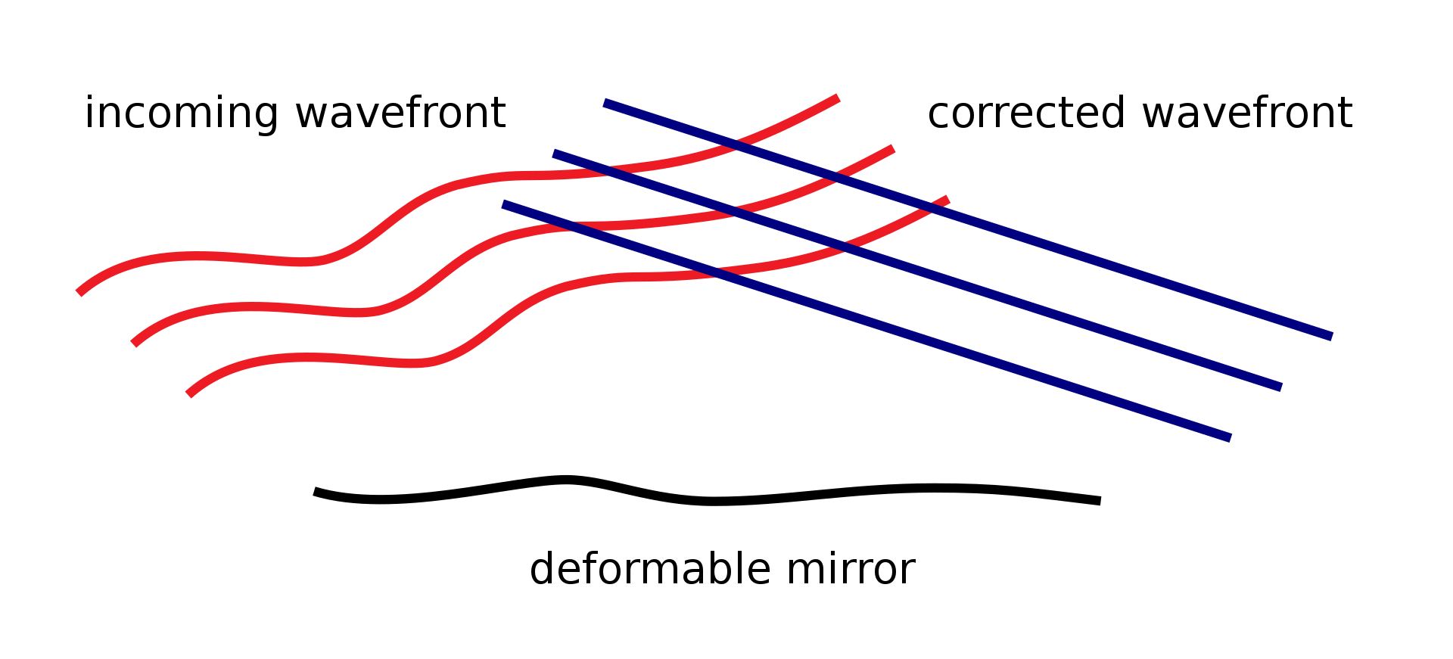
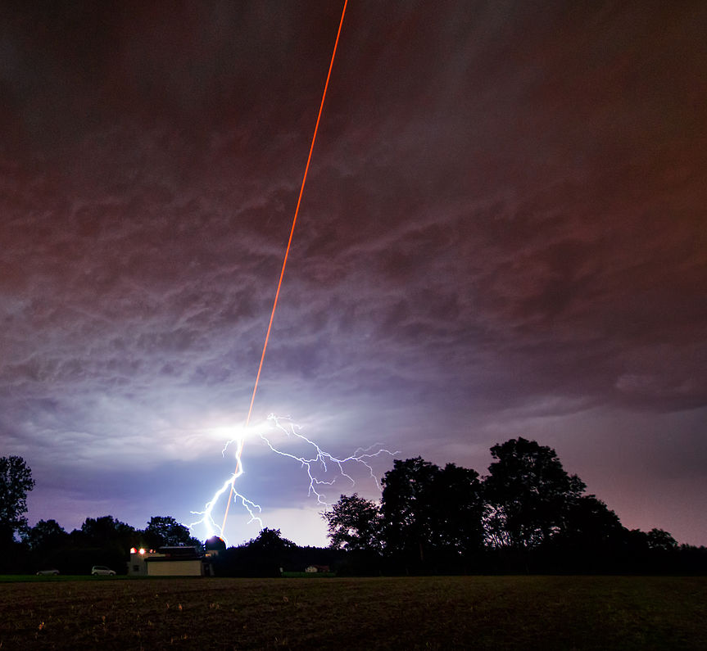
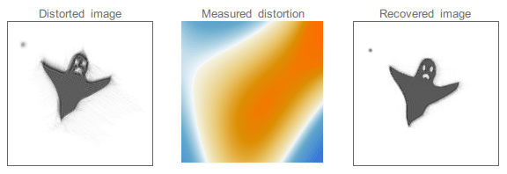
Adaptive Optics
Image: 2pem - Own work, CC BY-SA 3.0, https://commons.wikimedia.org/w/index.php?curid=15278966
Image: ESO/M. Kornmesser - http://www.eso.org/public/images/potw1136a/, CC BY-SA 3.0, https://commons.wikimedia.org/w/index.php?curid=16361914
Image: Jacopo Bertolotti
Notes:
Adaptive Optics is a system that actively monitors the incoming wavefront of light, and adjusts the optics to get maximum performance on the fly. Typically, adaptive optics for an astronomical observatory uses a deformable mirror in the light path. Incoming light is split between the imaging path and a wavefront monitor, so that the imaging system can monitor seeing conditions in real time. The deformable mirror in the lightpath matches the deformation of the wavefront and cancels out seeing distortion. To monitor the wavefront, a guide star is needed. In some conditions, where a bright star isn’t available, an artificial laser guide star is used. Most observatories use a powerful sodium laser to excite upper atmosphere sodium ions. The sodium ions in the upper atmosphere look like a star, and give the observatory wavefront analyzer something to use. Sounds expensive to me!

Slide 14
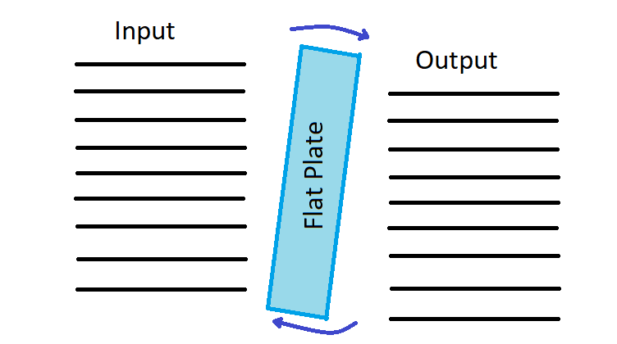
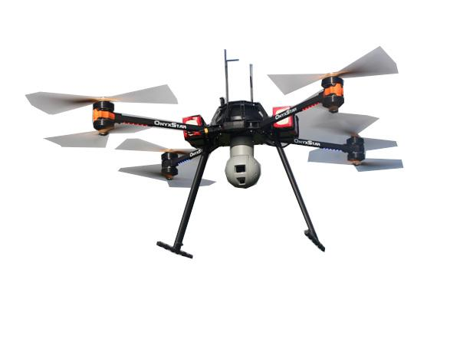
Amateur AO
Cheaper
Effective
Really Cool
Artificial guide stars for adaptive optics using unmanned aerial vehicles
Basden et al.
Image: ZullyC3P - Own work, CC BY-SA 4.0, https://commons.wikimedia.org/w/index.php?curid=43597088
Image from SBIG, used with permission.
Notes:
Adaptive optics are coming down in price significantly these days, however. For example, SBIG has recently released a 10Hz adaptive optics system called the AO-X, which they claim is capable of cutting seeing oscillation by nearly 50%. The optics are targeted toward advanced amateur astronomers, who can take advantage of the improvement in areas with regularly poor seeing conditions. The requirements for artificial guide stars are much less stringent as well now, with researchers this year finding that a drone can be sent to hover above an observatory as a guide star, rather than requiring an expensive sodium laser and hard-to-get permission from the FAA to use it. Over the next decade, I suspect that AO systems will be fairly common on amateur equipment.

Slide 15
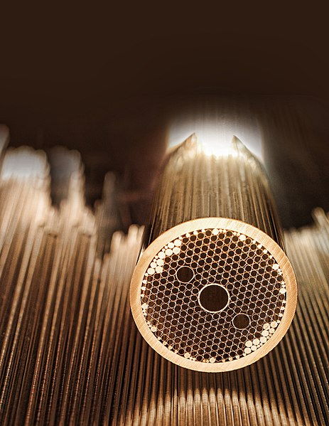
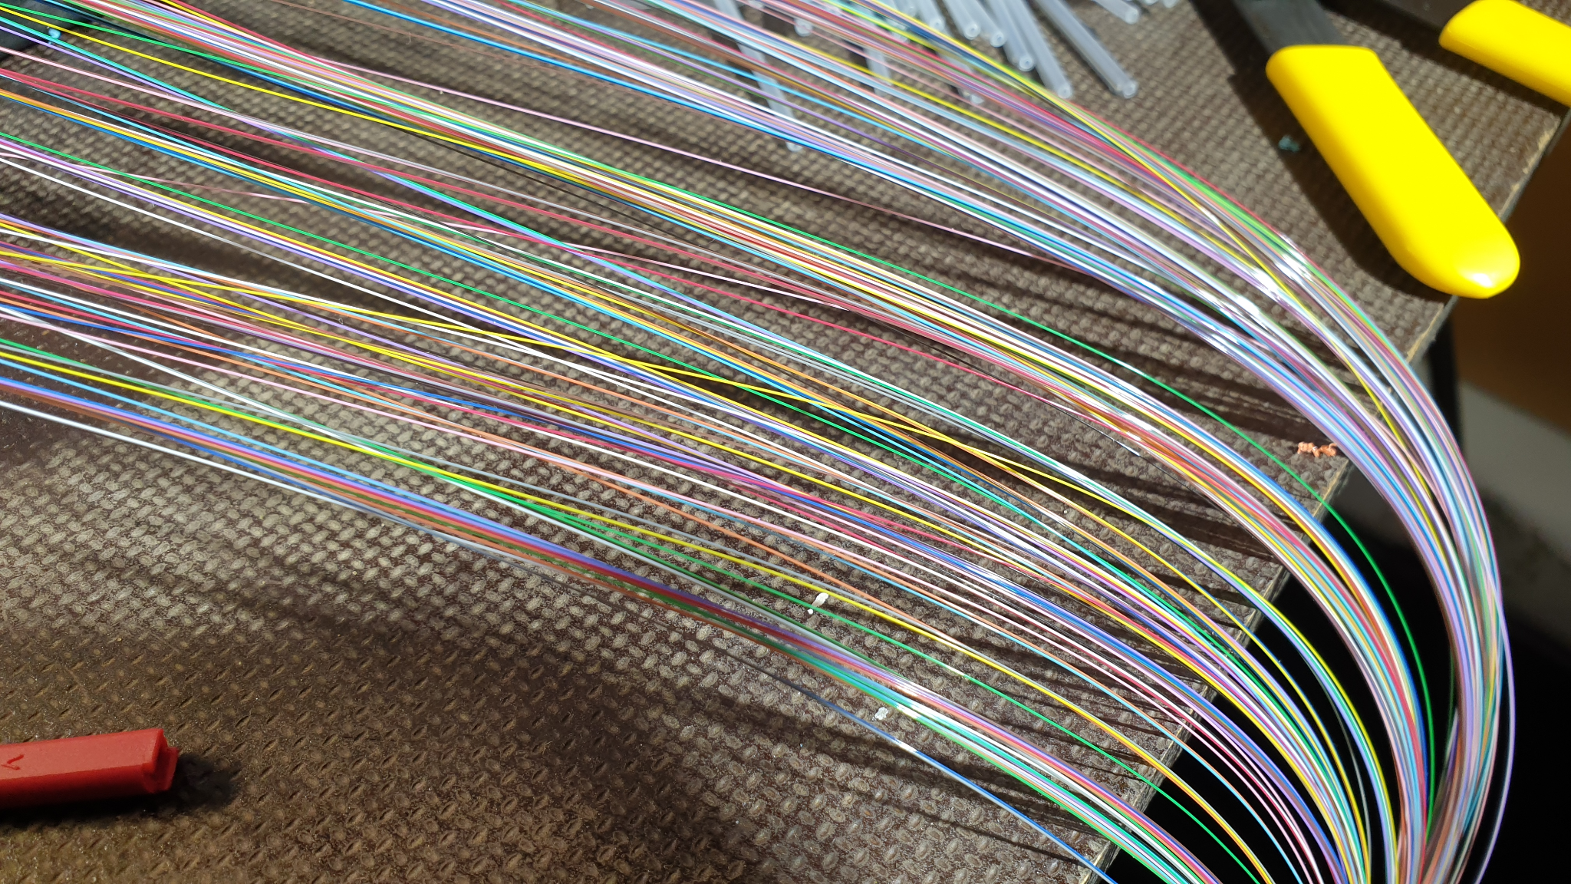
Fiber Optic Cable
Image: Pastèque24
Image: DARPA
Notes:
Fiber Optic cable is one of the older photonic technologies, but is finding it’s place in the amature astronomer’s toolkit in the design of precise and cheap spectrometers. In older, multi-mode fiber optics, light was treated from a geometric perspective; light would bounce from total internal reflection, and advancements targeted the transparency of the fiber optic material itself. Modern, single-mode fiber optics use unique, nano-scale patterns of holes along the fiber to propagate light, giving much longer transmission distances. For professional observatories, like the Giant Magellan Telescope and the Hobby Ebberly Telescope, hundreds or thousands of fibers and fiber bundles deliver light from the optical focus to spectrometers. Using a fiber optic cable to feed light into a spectrometer allows an astronomer to capture a much larger portion of the light of a star than using a slit does, and reduces noise from sky outside the star image itself. In addition, fiber optics can be moved with robotic positioners quickly and precisely, so that multi object spectra can be done with automation.

Slide 16
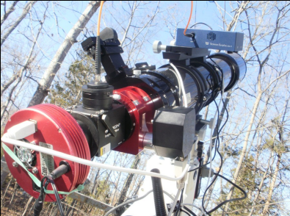
Fiber-Fed Spectrometer
To see more about this spectrometer, find Jerry Hubbell’s presenatation at raclub.org/Documents/Programs/Engineering-a-fiber-fed-spectrometer-for-astronomical-use.pdf
Image: Jerry Hubbell
Notes:
For the amateur, fiber optics can be just as useful for precision spectra of stars. This is a fiber-fed spectrometer designed, built, and used by Jerry Hubbell, where a small fiber optic cable picks up light from the center of the image and routes it to a DIY spectrometer. Compared to common diffraction grating spectrometers, this system has several benefits. A fiber-fed spectrometer has the ability to run the guide camera and spectrometer on the same optical instrument, which reduces error from using a separate guidescope. It also allows picking light from crowded regions of space, without having light from other stars bleed into the spectra.
All of these components have been pretty large, but not all of them are small. Some photonic implementations are microscopic, but can still make a big difference in imaging and science.

Slide 17
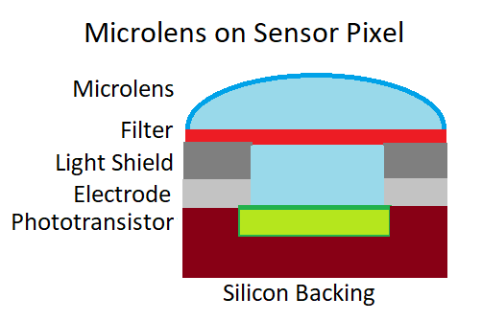
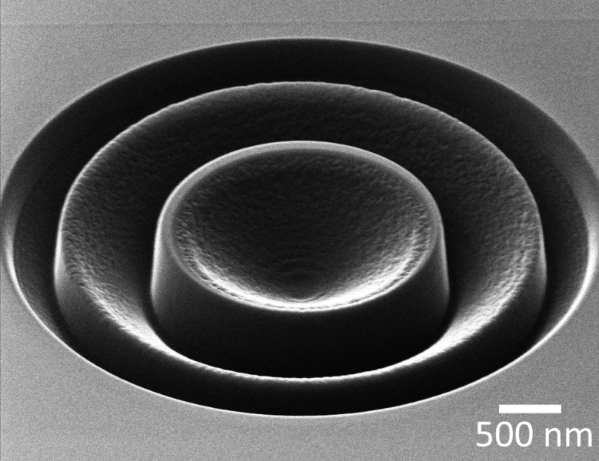
Microlenses and Metalenses
Image: Alexander Koshelev
Notes:
Microlenses and metalenses are exceedingly small! While the earliest microlens dates all the way back to Robert Hooke, recent advanced microlenses take advantage of semiconductor manufacturing methods in order to reach unforeseen levels of precision and accuracy. Microlenses are made using photolithography, laser ablation, and other nanoengineering methods, and are typically found on image sensors to prevent light absorbing into the electrodes. Metalenses take advantage of unique geometric properties in materials, and can be used to make structures like 2D lenses, or lenses with negative indices of refraction. Almost all of us use microlenses in our modern cameras, although we never really think about it. Each pixel is capped with a microlens that keeps photons from impacting the electrodes of the sensor, and instead redirects them onto the sensor itself. This increases sensor efficiency, giving us more photons in each second of exposure.

Slide 18
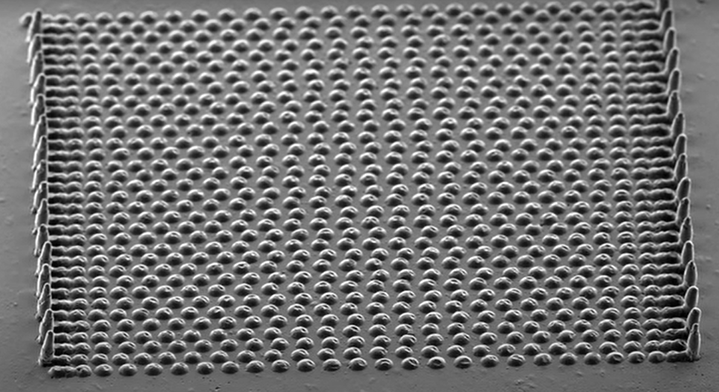
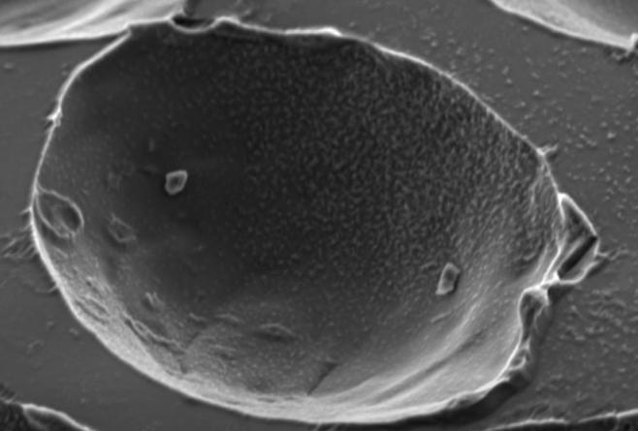
DIY Microlenses
Images: BreakingTaps
Notes:
You don’t need a billion dollar lab to make microlenses either. This year, an amateur scientist and YouTuber by the name of BreakingTaps made his own microlens array from scratch at home, and tested it with a homebrew scanning electron microscope. Here, you can see the microlens grid and mold he made under SEM.

Slide 19
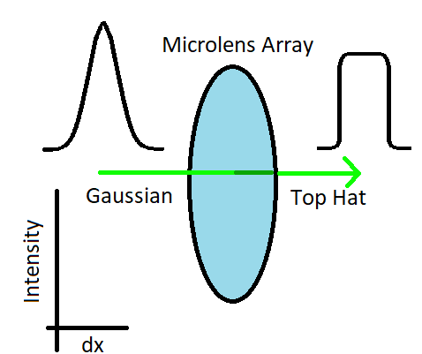
Engineered Diffuser
Diffuses light into an easily defined region of the image
Spreads photons evenly between many pixels, eliminating Gaussian spread
Application in precision photometry for exoplanets with millimagnitude scale
Stefansson et al. 2017
Notes:
Some astronomers are using engineered diffusers with microlenses to do precision photometery at the millimagnitude scale. These special textured filters convert the natural gaussian profile of light into a wide top hat shape. The net effect is similar to defocusing, which has been used in precision photometry for decades. The precise shape of the diffused light eliminates effects from sensor non-linearity, poor guiding, variable aberration and seeing, making a big difference for photometric precision. These diffusers can be had for roughly the same cost as an Ha filter, and allow ground based amateur astronomers to challenge space based telescopes for photometry of bright stars.

Slide 20
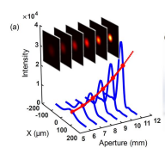
Aperture Modulation
Enhance image resolution beyond the aperture limit
Extrapolate images for larger diameter optics by taking images through several smaller apertures
Xu et al 2018
Image: Xu et al 2018
Notes:
Recent applications of Fourier optics have brought another advancement; super-resolution via aperture modulation. This technique uses a small telescope with an adjustable aperture to take a series of images at several aperture sizes, then extrapolates images for larger apertures from the data. Discovered only in 2018, this technique allowed researchers to more than double the effective resolution of their optics. Clearly, this technique could be of serious use for amateur astronomers with small telescopes.

Slide 21
Spectrometer on a Chip
High resolution
Reproducable
Durable
Small
High Production Volume
Use nano-scale manufacturing techniques and numerous methods of operation
Fourier Transform Method
Ring Resonator Method
MEMS Array Method
Notes:
Finally, I will bring up spectrometers on chips. These are unique devices that allow spectra to be taken on a similar platform to an image sensor or integrated circuit. Light can be piped in directly using a fiber optic, or the sensor can be placed directly at the focal point of the instrument. Standard diffractive spectrometers are large and occupy a lot of space, but a spectrometer on a chip doesn’t have that issue.
There are several competing technologies to put a spectrometer on a chip, each with different strengths and weaknesses. The Fourier transform type sensors have a broader bandwidth, while the ring resonator type spectrometers have higher resolution. Both types are capable of being built using existing CMOS technology, allowing rapid production. MEMS array spectrometers are currently available on the market, and use an array of magnetically controlled mirrors and concave grating surfaces to record a low resolution spectra. .

Slide 22
Review
Super-Resolution Algorithms
Drizzle
Wavelets
Adaptive/Active Optics
Fiber Optics
Microlenses and Metalenses
Aperture Modulation
Notes:
Through this talk, I have covered several different photonics approaches to astronomy for amateur astronomers. Super resolution algorithms can and do improve our image quality for free. Adaptive and active optics can improve our resistance to poor seeing conditions. Fiber optics can improve our ability to do precision spectra, and microlenses can improve our photometry. Future technology like aperture modulation and spectrometers on chips can allow us to miniaturize our equipment and do more with less.

Slide 23
The Big Takeaway
Photonics is rising in usefulness
We amateur astronomers can access it and use it
Notes:
I hope this presentation provides inspiration on ways to improve your equipment, images, and science. If you have any questions, please ask! I left a bit more time in this presentation to go in depth on any of these topics.

Slide 24
Presenter Contact:
Liam Plybon
blablabliam.github.io
512-818-2020
lplybon1@gmail.com
All images used with direct permission or according to license.

Slide 25
Papers of Note
Clause, Matthew. “Sparse Aperture Telescope Active Optics Report” 12, no. 3 (2016): 11.
Endo, Akira, Kenichi Karatsu, Alejandro Pascual Laguna, Behnam Mirzaei, Robert Huiting, David J. Thoen, Vignesh Murugesan, et al. “Wideband On-Chip Terahertz Spectrometer Based on a Superconducting Filterbank.” Journal of Astronomical Telescopes, Instruments, and Systems 5, no. 03 (June 21, 2019): 1. https://doi.org/10.1117/1.JATIS.5.3.035004.
“Hubbell - Engineering a Fiber-Fed Spectrometer for Astronomi.Pdf.” Accessed September 1, 2021. https://www.raclub.org/Documents/Programs/Engineering-a-fiber-fed-spectrometer-for-astronomical-use.pdf.
Hubbell, Gerald R. “Engineering a Fiber-Fed Spectrometer for Astronomical Use,” n.d., 43.
Hubbell, Gerald R., Barton D. Billard, Dennis M. Conti, Myron E. Wasiuta, and Shannon Morgan. “A Comparison of the Diffuser Method Versus the Defocus Method for Performing High-Precision Photometry with Small Telescope Systems.” ArXiv:1905.02790 [Astro-Ph], May 18, 2019. http://arxiv.org/abs/1905.02790.

Slide 26
Papers Cont.
Loktev, Mikhail, Gleb Vdovin, and Oleg Soloviev. “Integrated Adaptive Optics System for Small Telescopes.” Proceedings of SPIE, 2008 Vol. 7015 7015 (July 1, 2008). https://doi.org/10.1117/12.787893.
Shalaginov, Mikhail Y., Sensong An, Fan Yang, Peter Su, Dominika Lyzwa, Anuradha M. Agarwal, Hualiang Zhang, Juejun Hu, and Tian Gu. “Single-Element Diffraction-Limited Fisheye Metalens.” Nano Letters 20, no. 10 (October 14, 2020): 7429–37. https://doi.org/10.1021/acs.nanolett.0c02783.
Shkolnik, Evgenya L. “On the Verge of an Astronomy CubeSat Revolution.” Nature Astronomy 2, no. 5 (May 2018): 374–78. https://doi.org/10.1038/s41550-018-0438-8.
Stefansson, Gudmundur, Suvrath Mahadevan, Leslie Hebb, John Wisniewski, Joseph Huehnerhoff, Brett Morris, Sam Halverson, et al. “Toward Space-like Photometric Precision from the Ground with Beam-Shaping Diffusers.” The Astrophysical Journal 848, no. 1 (October 5, 2017): 9. https://doi.org/10.3847/1538-4357/aa88aa.
Xu, Biao, Zhiqiang Wang, and Jinping He. “Super-Resolution Imaging via Aperture Modulation and Intensity Extrapolation.” Scientific Reports 8, no. 1 (October 12, 2018): 15216. https://doi.org/10.1038/s41598-018-33416-9.

