Slide 1
Amateur Particle Astronomy
Liam Plybon
2-17-21
Notes:
Introduction. Mention my degree in physics and previous detector builds. This is not my job, merely something I do for fun, and I intend to improve upon what is shown here.

Slide 2
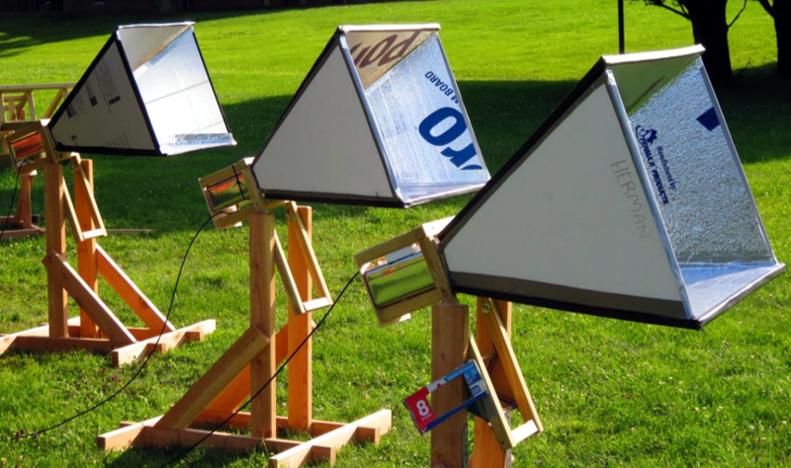
Expansions to Amateur Astronomy
Infrared
Ultraviolet
Radio
Particle?
Image: https://spaceaustralia.com/news/community-science-project-diy-radio-telescope
Notes:
First, I want to mention the explosion of new equipment in amateur astronomy in the last hundred years. While astronomy was long dominated by glass and eyepieces, camera equipment like film, CCD and CMOS technology has allowed observations in far more wavelengths than thought possible. Last month’s presentation of amateur radio astronomy shows not a brand new field, but a quickly growing sector of the industry powered by open source technology, cheap equipment and unique, satisfying results. It is my strong opinion that particle astronomy is where radio astronomy was twenty years ago; a sign of good things to come.

Slide 3
Particle Detection is Next
Technology advancements over the last 30 years are making particle detection equipment much more easily available to the amateur astronomer; unique questions can be answered with this equipment, and the need for an amateur observer presence may be fundamental for the field as it continues to grow.
Notes:
Particle detection has gone down in price nearly two orders of magnitude; photodetectors no longer have to be pressicion vacuum tubes, scintillators no longer have to be expensive, water sensitive crystals. Some computers are cheaper than a morning coffee, and information on the subject has never been more availible than it is today. Questions like, “where do cosmic rays originate?” are still open in discourse. Multi-Messenger astronomy is the exciting development of our time, and I hope this presentation makes you think about particle physics a little bit.

Slide 4
Types of Particles
Notes:
First, lets talk a little about particles!

Slide 5
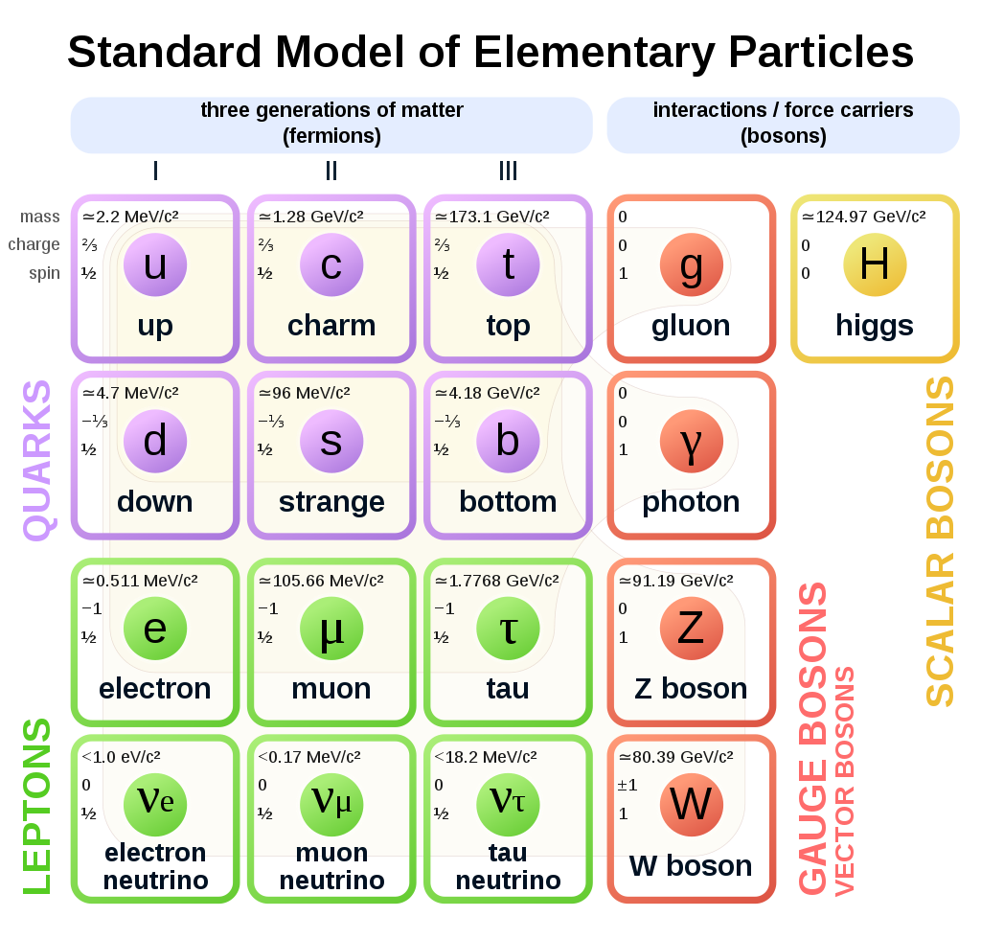
Why Particles Matter
Varied methods
for detection
and observation
By MissMJ, Cush - Own work by uploader, PBS NOVA [1], Fermilab, Office of Science, United States Department of Energy, Particle Data Group, Public Domain, https://commons.wikimedia.org/w/index.php?curid=4286964
Notes:
This chart shows the diversity of the field. These are only the elementary particles of the standard model, so you will notice particle mainstays like protons and neutrons are not present here, although there are a few familiar faces.

Slide 6
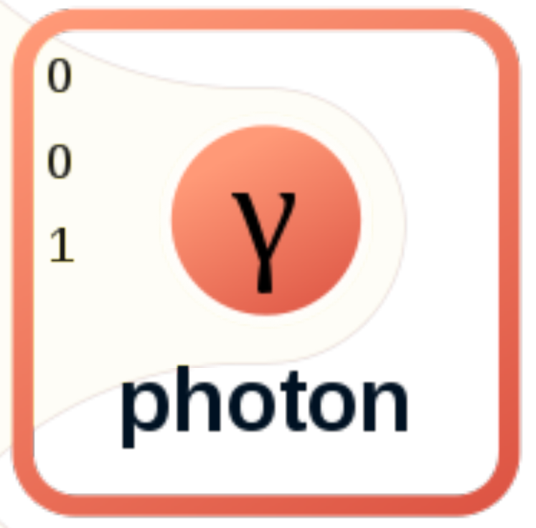
Most Important!
Eyes
Film
CCD
CMOS
Notes:
For starters, the most important particle in astronomy, now and forever; the photon. Odds are, yall are more experienced in photon detection than I am, and have been detecting photons in just about every way possible. Everyone gets free particle detectors, eyes, and has a particle detector or two on their smart phone, the camera.

Slide 7
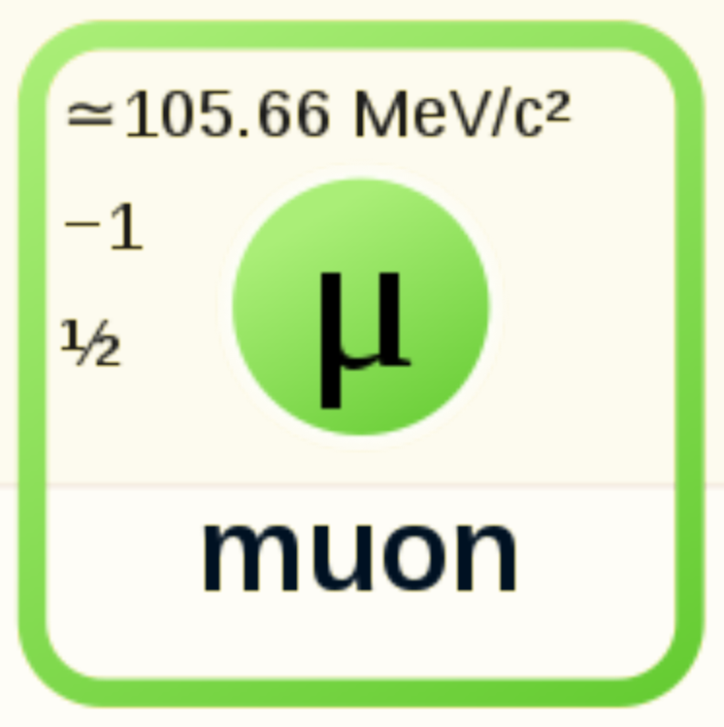
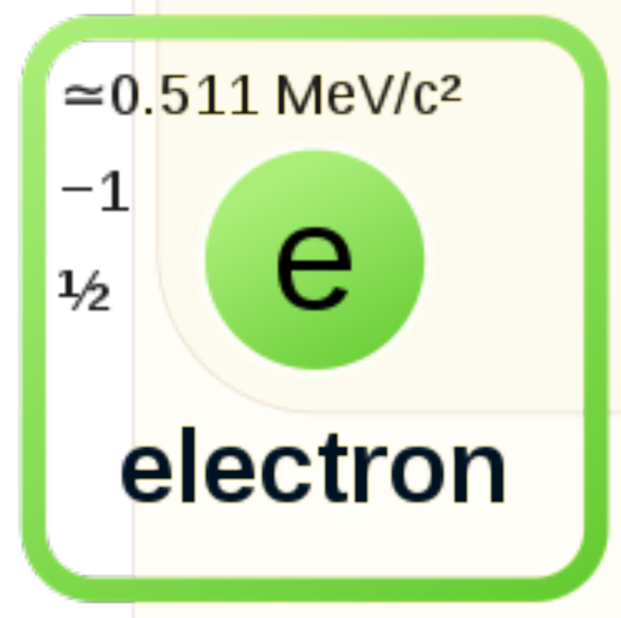
Muons
Mass
Charge
Spin
Notes:
Another particle I want to talk about is the Muon. Here, I put the muon side by side with an electron so we can compare. Both are leptons, meaning they have half spin, and both are stable enough to be observed by amateur equipment.

Slide 8
Muons
Mass
Charge
Spin
Notes:
You might notice that the muon has 200x electron mass, so collisions may release more energy. If an electron is a speeding bullet, the muon is a speeding brick.

Slide 9
Muons
Mass
Charge
Spin
Notes:
Charge and spin are identical, so we can mostly ignore them. Meanwhile, the Half Life of a muon is 2 microseconds, barely enough time to get through the earth's 10,000 km atmosphere. Additionally, muons can travel through radiation shielding that would absorb electrons. How would a particle like this be relevant for astronomers, interested in much greater distances?

Slide 10
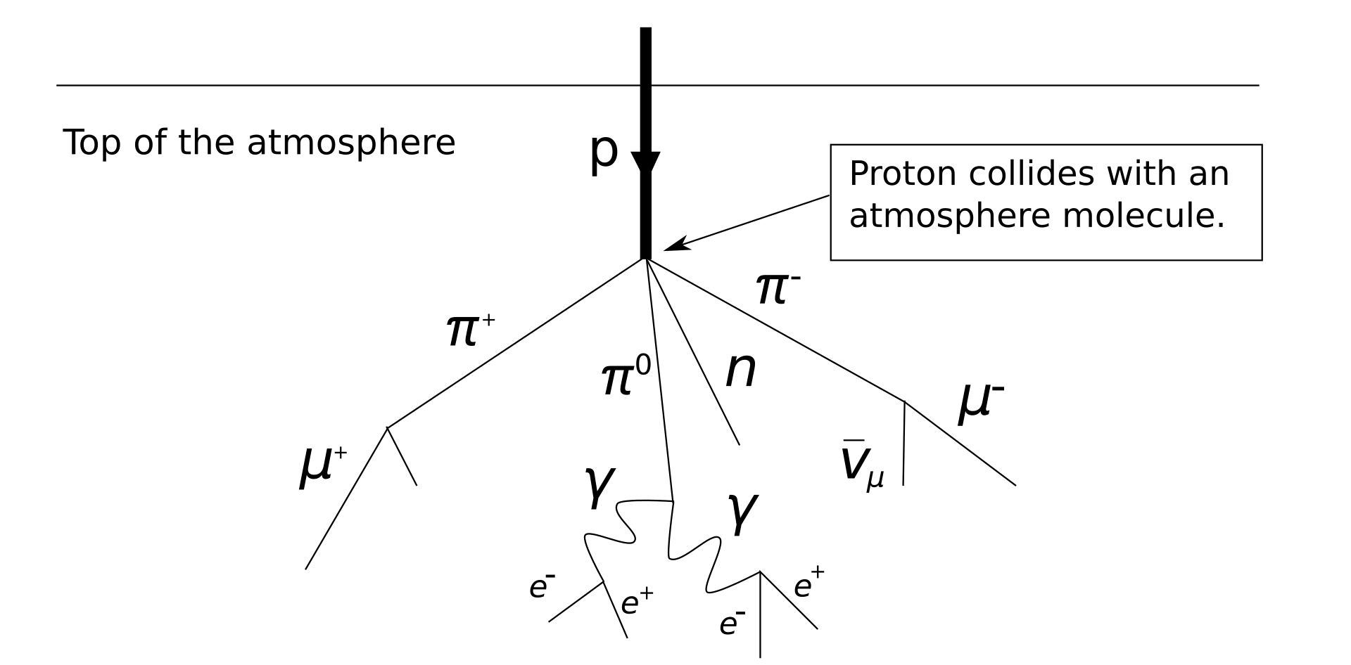
Cosmic Rays
Pion
Muon
Gamma
Ray
Electron
By SyntaxError55 at the English Wikipedia, CC BY-SA 3.0, https://commons.wikimedia.org/w/index.php?curid=13361920
Notes:
Cosmic rays are particles from space with enormous energies; some approaching that of a thrown baseball. Cosmic rays are typically protons, but some of them can be heavier nuclei or even rarely antimatter. They create a particle cascade when they hit the upper atmosphere, and it is these secondary particles that we detect with various methods. One of these resulting particles, the easiest to detect with DIY equipment, is the Muon.

Slide 11
Muon Detection
Notes:
Lets get into the DIY part; detecting particles!

Slide 12
The Parts of a Detector
Interacting Target (Tube or Scintillator)
Signal Creation (Electron Cascade)
Signal Amplifier
Signal Counter and/or Coincidence Detector
Notes:
Every particle detector has a few basic parts: something to interact with the particle, called a target. Something to create an electric signal, followed by an amplifier, and finally a counter and/or coincidence detector. Unlike cameras that produce a picture, a particle detector is like a radio and only produces one data value.

Slide 13
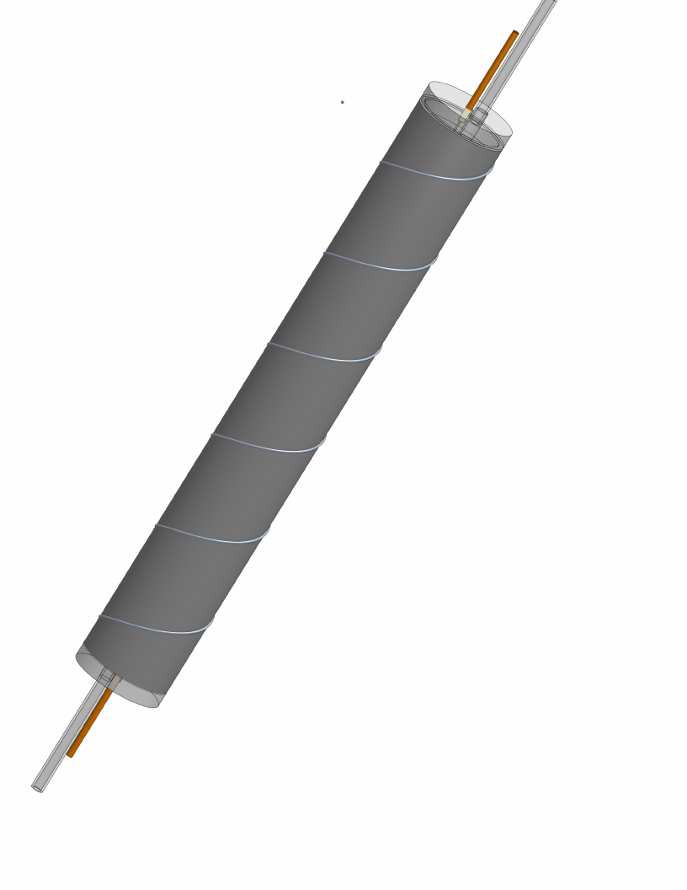
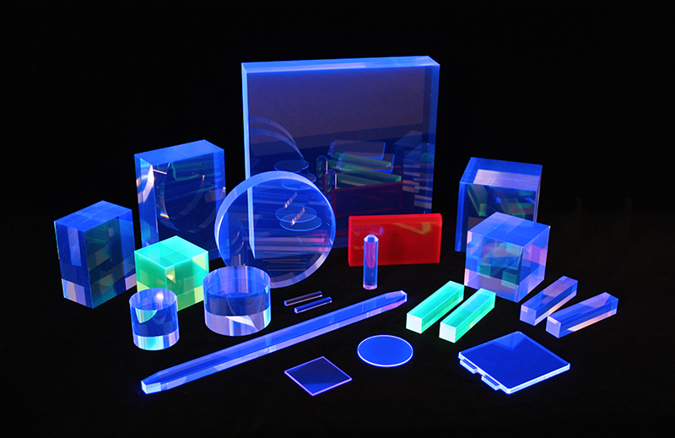
Types of Targets
Geiger Tubes
Scintillator Detectors
Image Credit: https://eljentechnology.com/
Notes:
There are two types of targets that I will discuss today; Geiger tubes and Scintillator detectors. These types of detectors allow us to convert a tiny particle interaction into a massive, detectable signal.

Slide 14
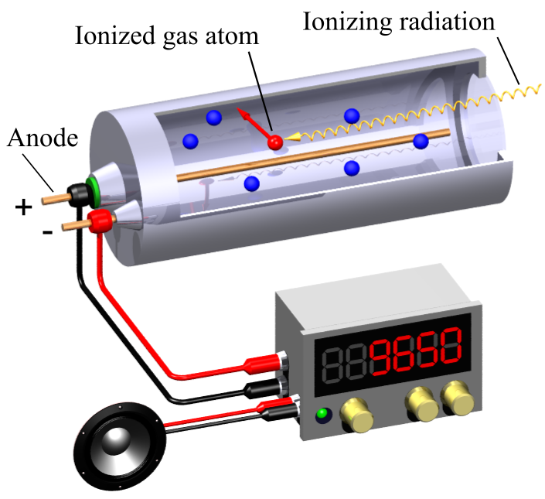
Geiger Muller Tube
Geiger tubes are some of the earliest detectors, and can be purchased for fairly cheap online around 40 dollars. They tend to be for detecting harmful radiation, rather, than cosmic rays, so it may be more prudent to build your own.
Notes:
Geiger tubes are simple detectors that use a high voltage capacitor breakdown to detect radiation. We have all seen geiger counters used in movies with nukes, and due to the economic incentives of the cold war almost all geiger tubes on the market are Soviet or US in design optimized for radiation caused by nuclear weapons.

Slide 15
DIY Geiger Tube
Materials:
Fluorescent Light Bulb Tube
5mm Glass Tube
3mm Copper Pipe
0.19mm Tungsten Wire
Epoxy Drilled Caps
Epoxy
99:1 Helium/Butane Gas Mix
2kV Power Supply (low amp supply)
Notes:
A Geiger tube is really simple to make. This tube was made in a college lab class, with less than 40 dollars of material. There is a cut piece of glass tube inside, with the ends capped in epoxy. Thin glass tubes on the end allow target gas to slowly flow through the tube. The middle of the tube suspends a thin, tight tungsten wire while the outside of the tube is wrapped in tin foil, electrical tape and bailing wire. Together, the wire and the shell make a large capacitor connected to a low current, high voltage DC supply.

Slide 16
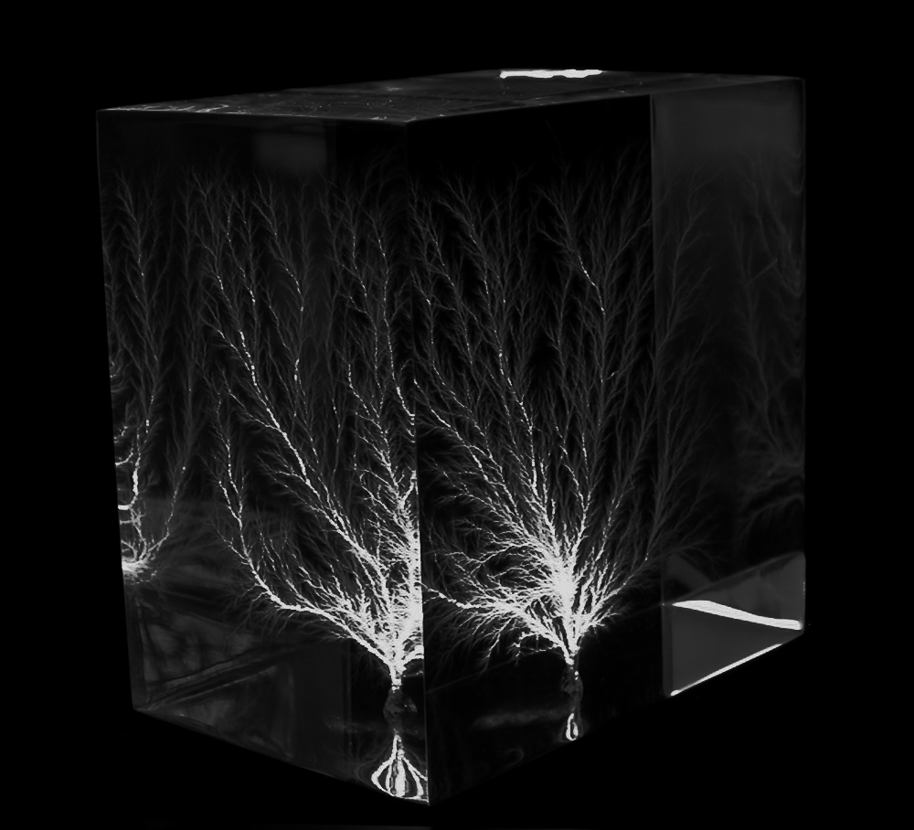
Geiger Tube
Muons pass through exterior shielding into the tube.
Muons collide with gas inside the tube, breaking off electrons like a billiard.
Free electrons accelerate toward the charged center wire, gaining energy.
Fast electrons break electrons off of other molecules as they are accelerated, quickly multiplying the number of free electrons in the tube.
Electrons hit the positively charged center of the tube, creating a brief, low current short between the high voltage wire and the grounded outer tube.
By Bert Hickman, http://capturedlightning.com - English Wikipedia, original upload 8 February 2005 by Bert Hickman, Attribution, https://commons.wikimedia.org/w/index.php?curid=466577
Notes:
To quickly explain the detector’s method of operation, Geiger tubes allow particles to collide with gas and create an electron avalanche. First, particles of interest pass through the exterior shielding of a tube, where they collide with the target gas inside like billiard balls. In my case, the target gas is helium and butane. These collisions knock off electrons, which are pulled toward the center wire at high speed. These electrons are able to collide as well, and knock off even more electrons. When the avalanche of electrons hit the center wire, a small, nanosecond scale pulse of current is sent out: victory!

Slide 17
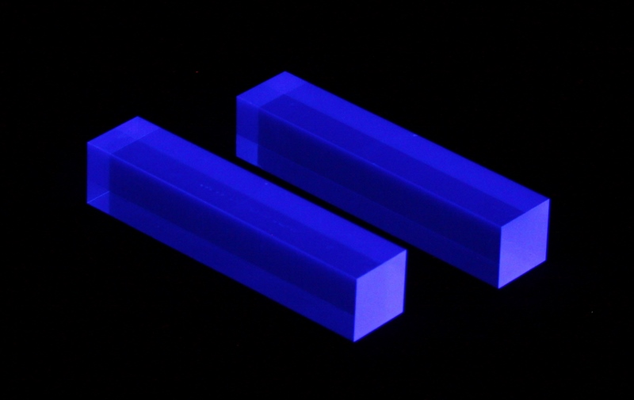
Scintillator Detector
Common scintillator materials, like NaI(tl) crystals, can be both expensive and hard to work with due to their hygroscopic qualities. New scintillators, like epoxy scintillator, are much easier to work with, and are far cheaper.
Notes:
With a scintillator detector, the cost of material has gone way down. Previous technology used expensive, hard to grow crystals with difficult to work with properties. Today, a scintillator epoxy can be mixed up, with custom response ranges, for far less cost. They can also be far larger than the grown crystals, another nice benefit.

Slide 18
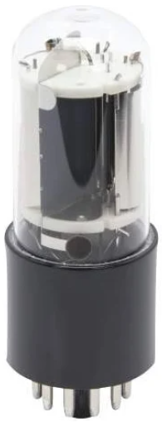
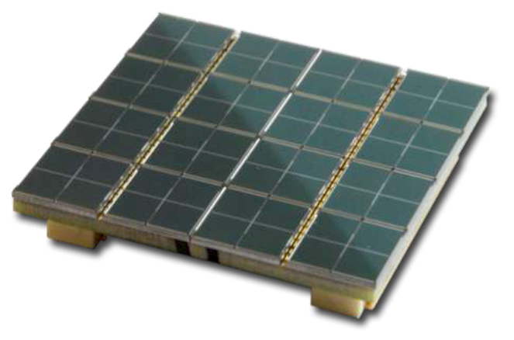
Scintillator Detector
Detecting light from the scintillator used to be done with photomultiplier tubes, costing well into the thousands to tens of thousands of dollars. Silicon photomultipliers can be purchased new for less than a hundred dollars.
Notes:
Detecting scintillator emissions used to be done with photomultiplier tubes, costing thousands of dollars. These tubes were very fragile, and could be broken with vibrations and drops. Silicon photomultipliers are orders of magnitude smaller, and can be just as effective at a tenth of the price.

Slide 19
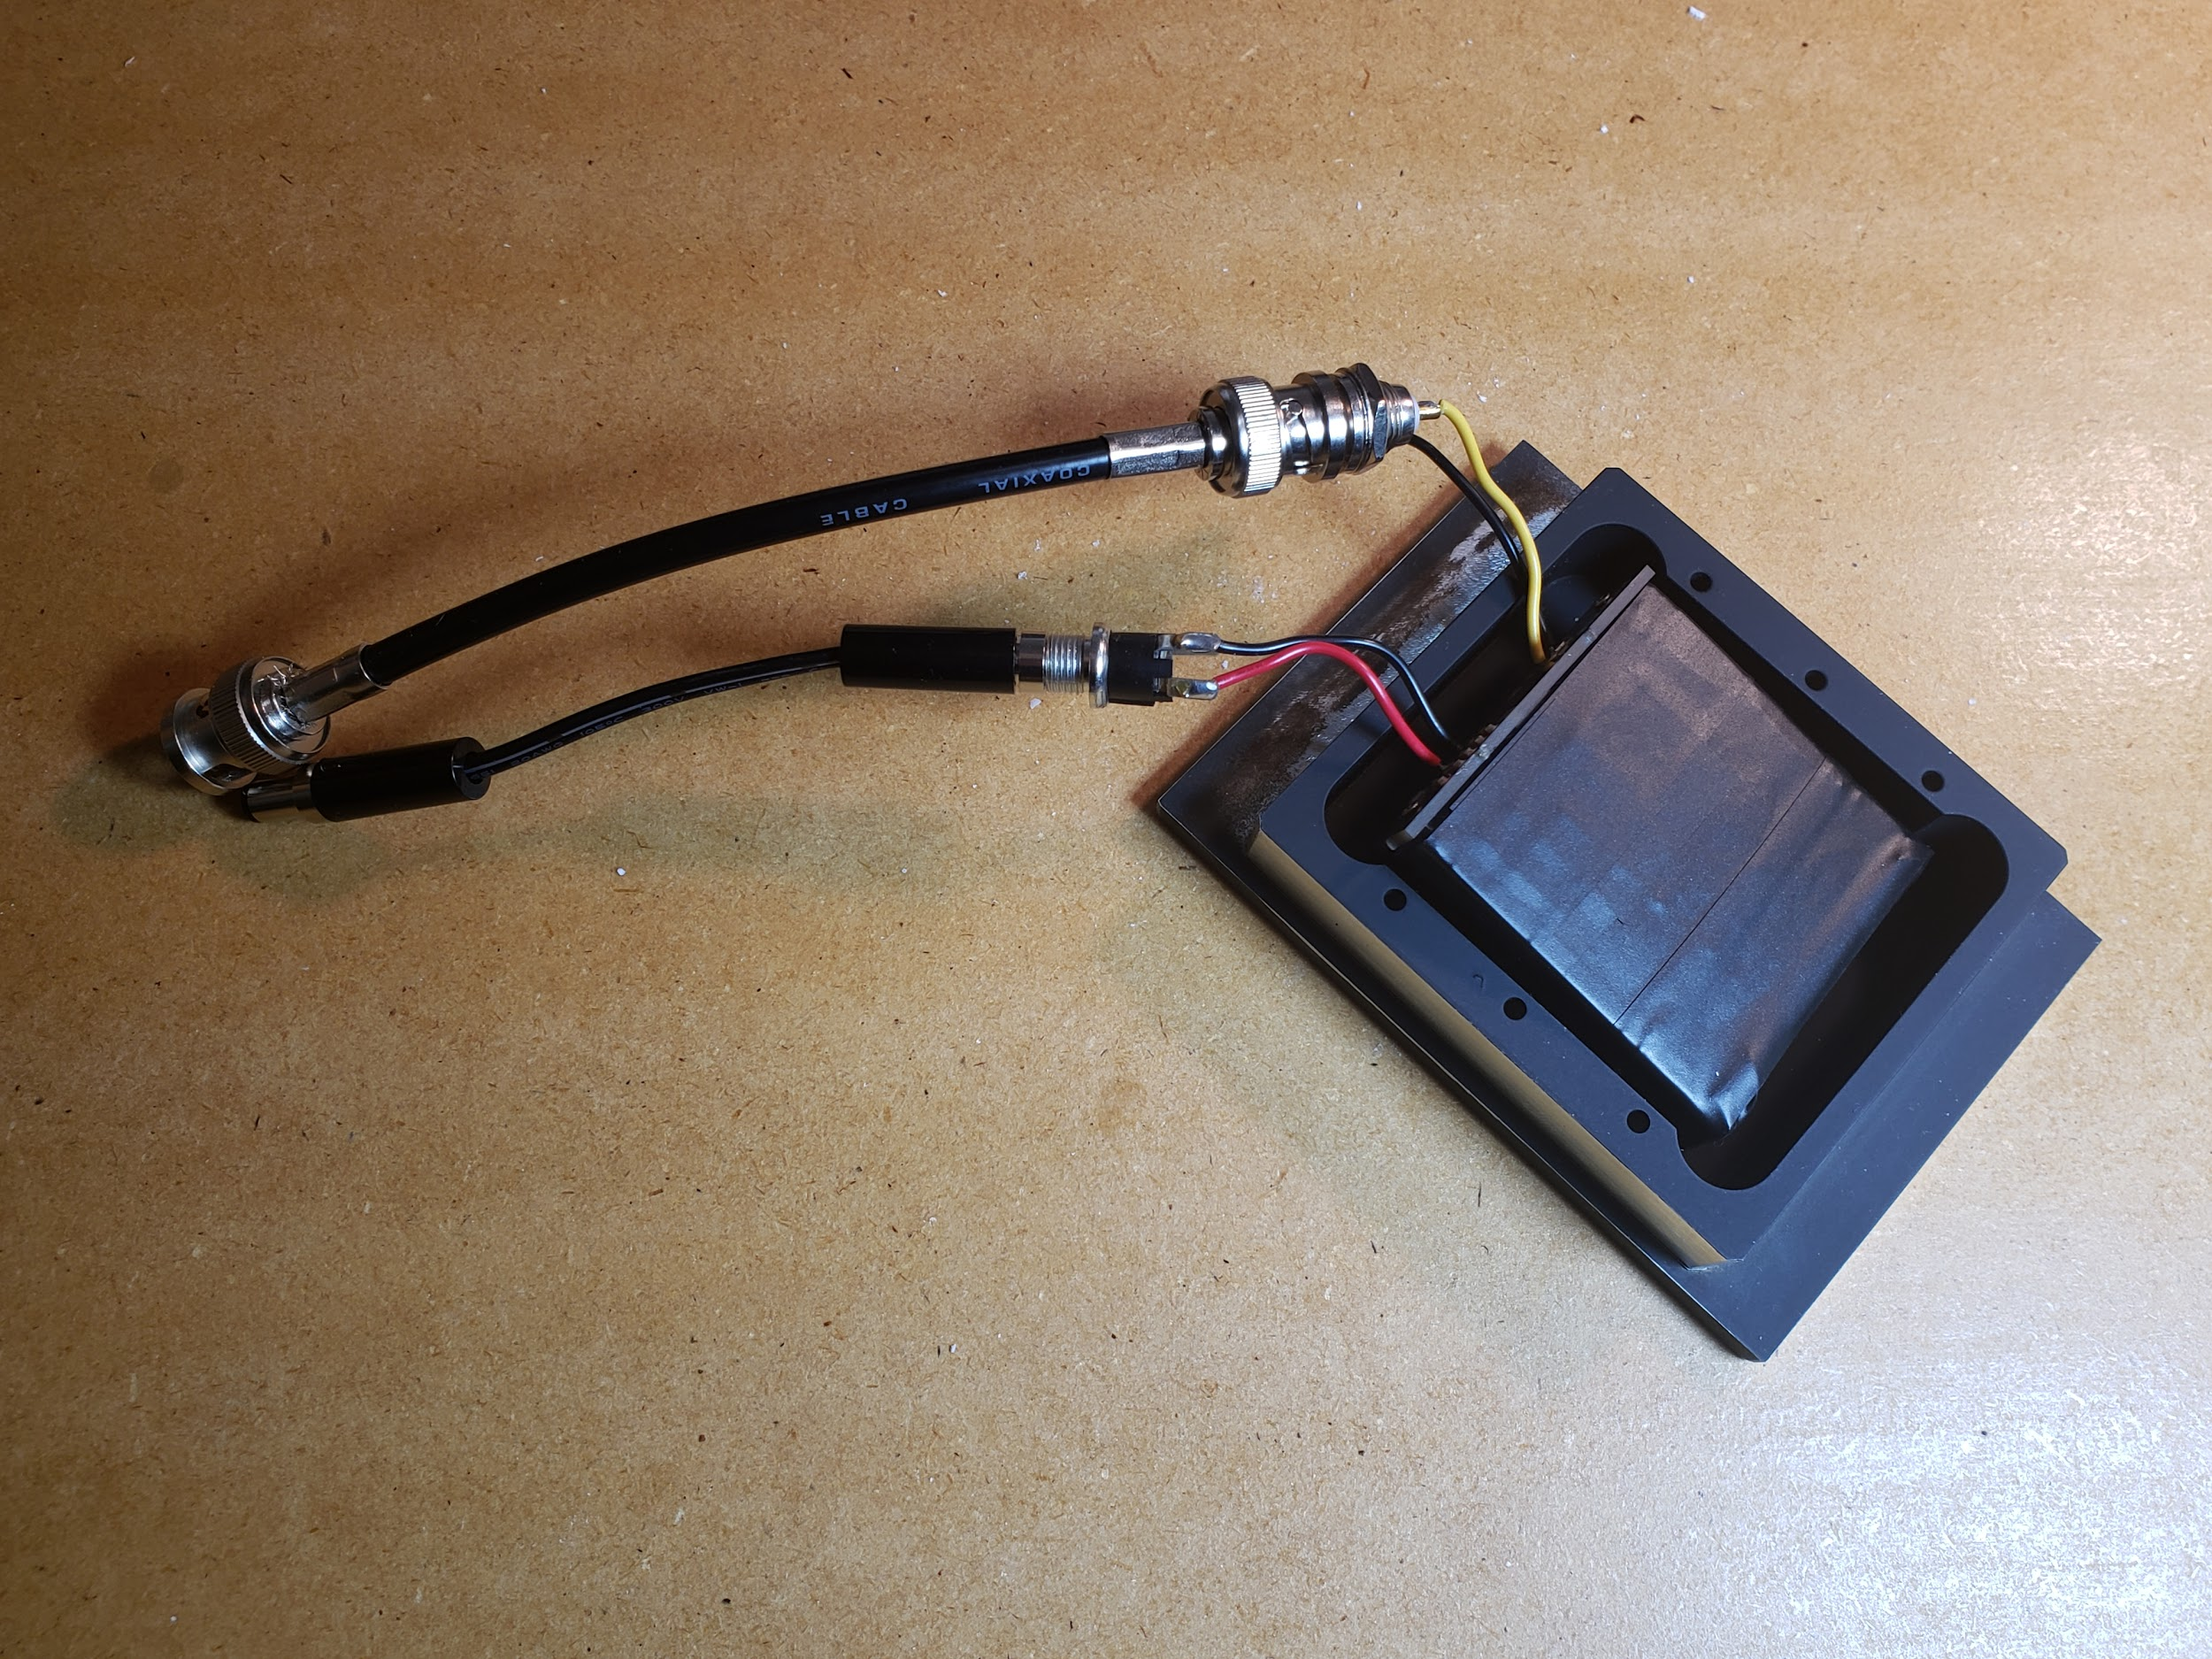
DIY Scintillator Detector
Materials:
Scintillator Epoxy
Silicon Photomultiplier (SiPM)
Pulse Shaper Circuit
Light Tight Enclosure
29.5V DC Power Supply
Notes:
A scintillator detector is smaller, and doesn’t have the same requirements for constant gas flow or high voltage! This makes it much safer to work with, and while it may be more expensive and harder to build, it is still well within the budget of the hobbyist. This detector consists of a 50 dollar brick of scintillator epoxy, a 100 dollar silicon photomultiplier, and a custom milled light tight aluminum box coming to nearly 200 dollars in total; cheaper than an autoguider! You can tell I made this recently based on how nice it looks! The scintillator detector I built here is based of of a muon detector called the Cosmic Watch, an open source project that has been a huge help to me.

Slide 20
Scintillator Detector - A Familiar Tale
Particles of interest enter the detector by passing through the shielding.
Particles collide with fluorescent additives in the scintillator epoxy, called fluors, producing photons of a narrow wavelength.
Photons are absorbed by the silicon photomultiplier, where they cause a diode in an array near breakdown voltage to breakdown.
The entire diode array breaks down at once, causing a familiar electron avalanche to hit the cathode of the photomultiplier.
Notes:
Now, to explain the function, muons once again pass through the shielding and hit a target; in this case fluors. These molecules are suspended within clear epoxy, and emit a specific frequency of light when collided with. The light bounces around inside the clear epoxy until it hits the photomultiplier. A silicon photomultiplier detects these quick pulses of light, turning single photons into low voltage, nanosecond scale pulses of current. Like the slide reads, a very familiar story. The picture here shows my photomultiplier, soldered to a circuit board.

Slide 21
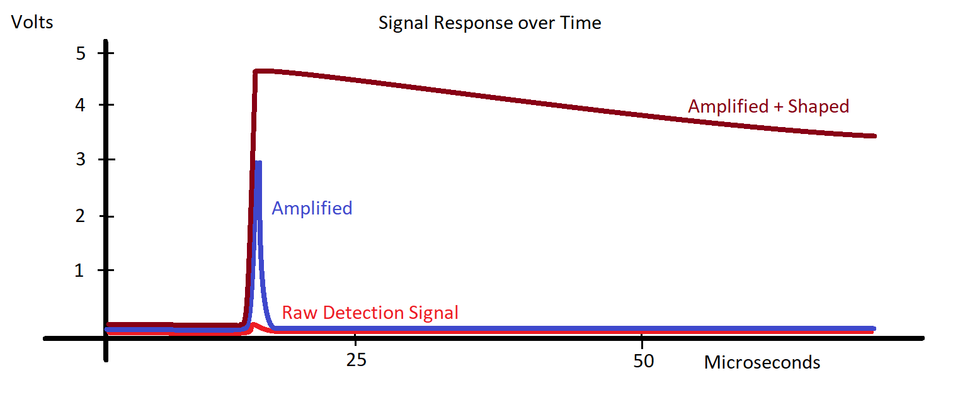
Amplifier Circuit
Output of both detectors is around 80 mV, and 10 ns long. This is resolvable on a quality oscilloscope for testing, but to do any kind of useful work the signal requires amplification and shaping. Typical microcontroller inputs work around 300-500 mV, setting a good goal. Additionally, this pulse rate is too fast for most devices to catch, so it needs to be lengthened by a pulse shaper to a few hundred microseconds at least.
Notes:
The signal from the detector is miniscule, and needs to be amplified and stretched even further. In the case of these detectors, the signal needs to be amplified quite a bit; about 500 percent, and lengthened to the point that an analog input can read it with more than one sample. On this plot, I have the raw detector output in red, the needed amplified signal in blue, and the lengthened signal in maroon. You can see how much of a change we need to make here! Thankfully, this is much easier than it looks.

Slide 22
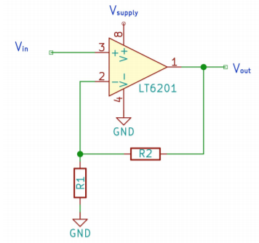
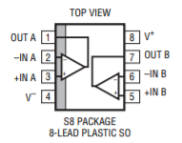
Amplifier
5V
The LT6201 Non Inverting Amplifier is a cheap way to boost the signal, costing only about three dollars on Digikey. With low noise and high gain, it can easily hit the required pulse height. Better yet, it is available in a small package for use on circuit boards. Here is a circuit schematic of the amplifier used on my latest detector, and the practical implementation.
Detector Pulse
Amplified
Signal
https://arxiv.org/abs/1606.01196
Notes:
We can use the LT6201 Amplifier IC to do this quickly and cheaply. In non technical terms, this little integrated circuit amplifies the signal input according to the connected resistors, allowing us to easily tune the amplification as needed. It takes a 5V input, which any USB port can easily provide, and can be soldered by hand for people on a budget like us. It is a perfect match for the particle detector.

Slide 23
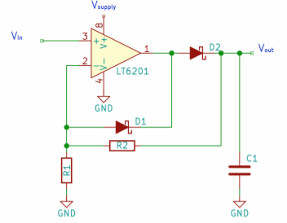
Pulse Shaper
5V
Once again, the LT6201 Non Inverting Amplifier comes to the rescue! A pulse shaper can be made using the amplifier in this combination, with the first amplifier feeding directly into the pulse shaper. The pulse shaper holds it’s output to high while the capacitor in C1 discharges through the resistors, so the new pulse length is easily adjusted.
Pulse Amplifier
Output
Pulse Shaper Output
https://arxiv.org/abs/1606.01196
Notes:
To shape the pulse and lengthen it, we once again use the same component! In this configuration, the shaper is able to hold it’s output high as long as the capacitor is charged. It is easily tuned, and works great on a budget. There is no need to buy a second amplifier IC either, because each IC comes with two amplifiers. All together, you can print a circuit board and populate it with these components for less than 10 dollars.

Slide 25
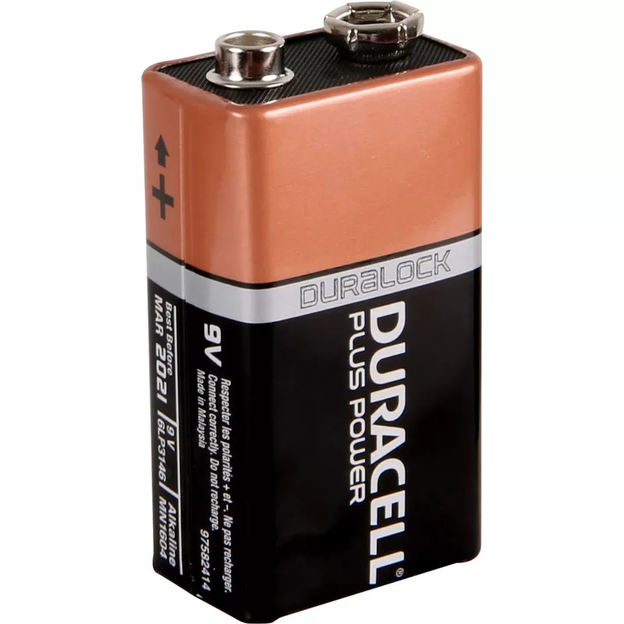
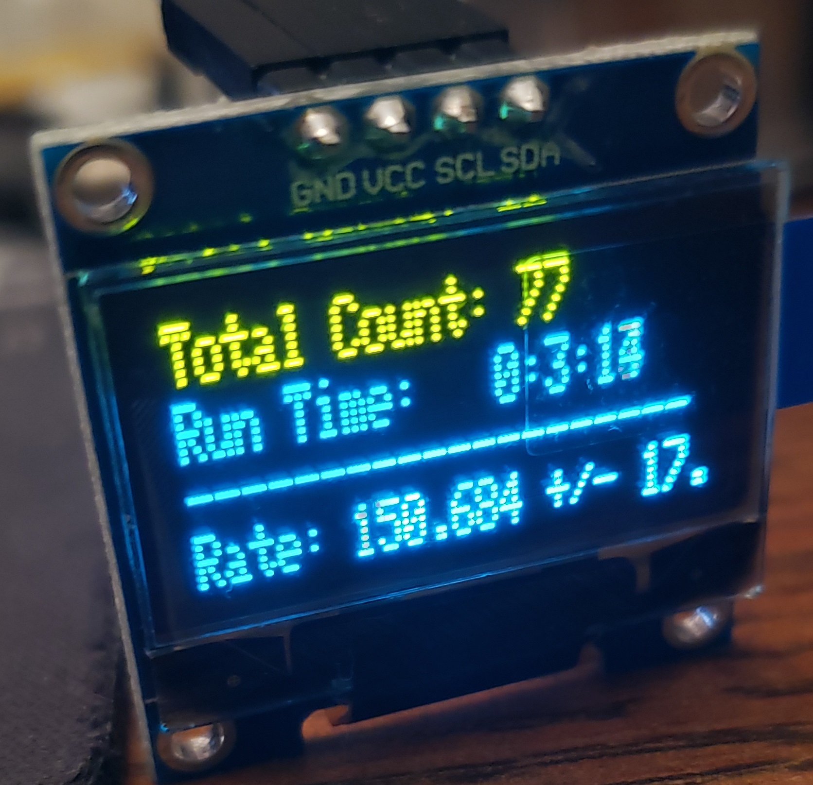
Coincidences and Counts
Arduino Nanos are cheap at around 5 dollars, and are capable of reading the output from the pulse amplifier and shaper directly on an analog pin. They run on 5-9V, output 5V for the amplifier. In addition, the arduino can be installed directly onto a board with the amplifier for a small and discrete package, operable with a simple USB power bank or rechargeable battery. They can output to the computer, or a simple screen when on the go.
By AJ from openclipart.org
Arduino.cc
Notes:
Rather than try to build something from scratch, we can lean on the venerable Arduino to handle counting or coincidence detection. For those not familiar, the arduino is a cheap, easy to program microcontroller that finds work both in the research laboratory and elementary classroom. I have personally taught children to write programs for the arduino, which is a testament to how intuitive they can be. In this case, the arduino can be used to count the pulses from the detector as it runs, and has the added benefit of providing the perfect power to run a pulse shaper and amplifier circuit.

Slide 26
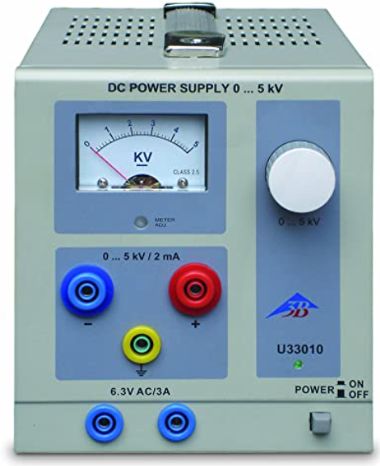
Powering the Detector
Scintillator:
To power the detector, a buck boost converter can be purchased for around 5 dollars, converting the 5V power to a tunable value. In the case of an SiPM, the voltage should be set to 29.5V.
Geiger Tube:
The Geiger tube needs around 2kV, which should only be provided by a safe voltage source. High voltage electricity can be a lethal hazard if proper care is not taken. I used a lab bench power supply, which costs around 500 dollars.
3B Scientific Store
Components 101
Notes:
Unfortunately, an arduino is not strong enough to power the detector on it’s own. For the scintillator detector style, a small buck boost converter can run off of the arduino’s own power input, running off of the same power source as the pulse shaper. The geiger tube requires a potentially dangerous high voltage supply, so I would suggest using a proper lab power supply, rather than a homebrew voltage source like a microwave oven transformer. In addition, the stability of a lab power supply is far superior.

Slide 27
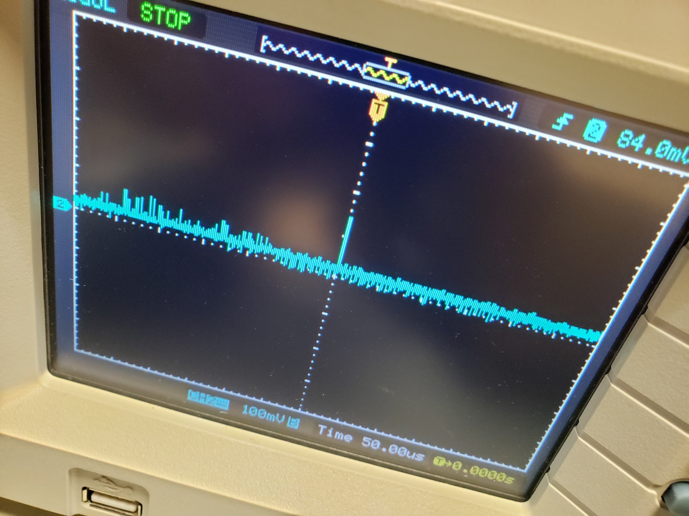
Putting it Together
Each of the parts should be tested independently to make sure it is working. The power sources should be checked with a multimeter, while the pulse shaper circuit and counter should be tested with an oscilloscope.
Notes:
Before putting the detector parts together, I suggest testing parts one by one to prevent frustration. This picture is on oscilloscope triggered on a particle detection, raw from a scintillator detector. The timescale shows that the pulse is under a microsecond, and the height is around 100mV as expected. Once it passes through an amplifier and pulse shaper, the signal will be far more clear.

Slide 28
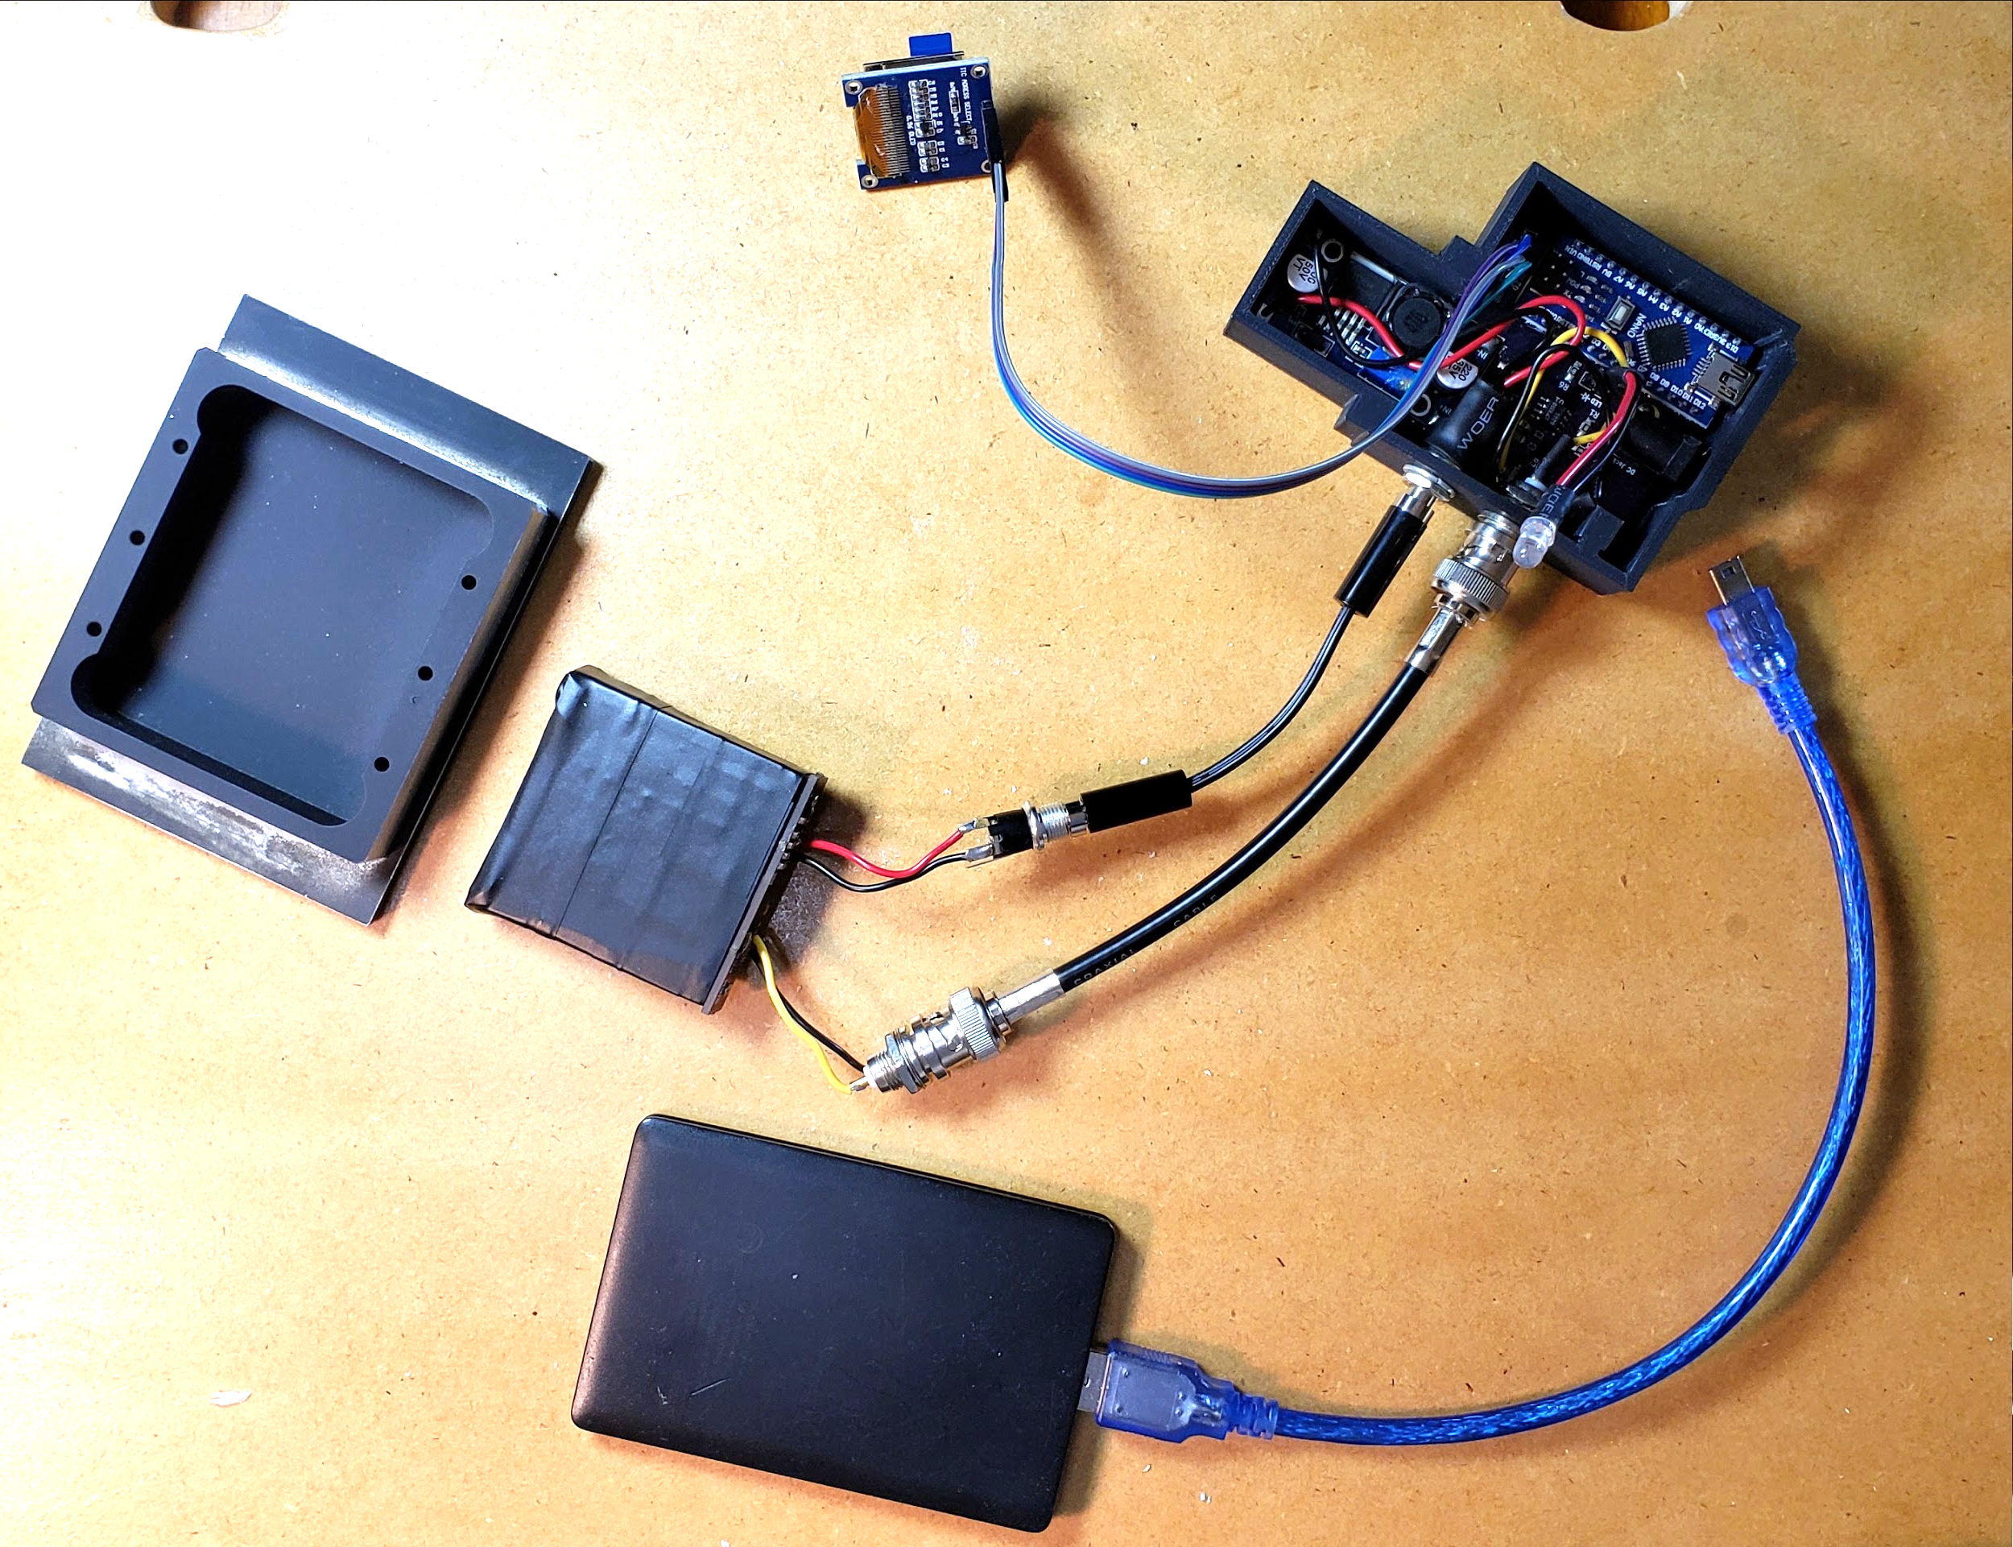
Assembled Scintillator Detector
Screen
Buck Booster
Shaper + Counter
Box
Scintillator
Power
Signal Cable
Battery
Notes:
Here is what my scintillator detector looks like when all together and opened. The buck booster, pulse shaper and counter arduino are in a small 3D printed housing, which makes them a little hard to see here.The battery connects to the setup using the USB cable, the detector gets power through a short barrel connector cable, and the pulse shaper connects to the detector signal with a coax cable. Each pulse is counted by the arduino and output to small screen in the top of the picture. It looks a little unruly, but is fairly compact. Unfortunately, I don’t have any pictures of the assembled tube detector availible.

Slide 29
Experiments
Notes:
Here is where I talk about some of the experiments you can do with this type of detector.

Slide 30
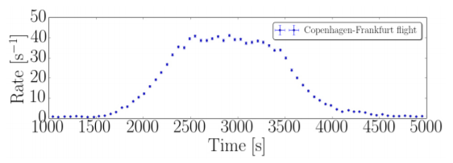
Cosmic Ray Flux Rate
Cosmic ray flux rate can be measured in various locations using these types of detectors. While this may seem useless, it does allow you to get a background radiation measurement when doing other particle physics experiments. Cosmic ray flux rate depends strongly on altitude, as well as shielding between the detector and space.
https://arxiv.org/abs/1606.01196
Notes:
One popular experiment with this type of detector is recording cosmic ray flux rate at various altitudes and depths. This plot, from an Arxiv paper, shows cosmic ray flux during a plane flight; the flux rate clearly depends on the altitude of the plane.

Slide 31
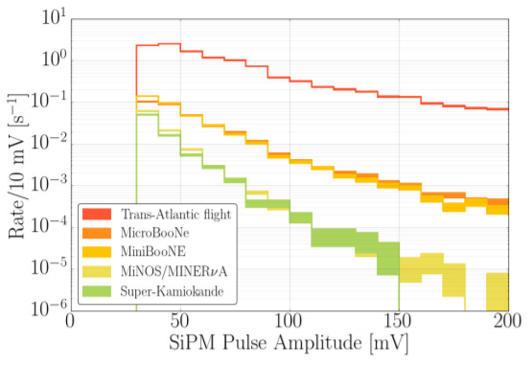
Cosmic Ray Flux Rate
https://arxiv.org/abs/1606.01196
Notes:
This plot shows the intensity of cosmic rays measured at various depths, again from the same paper. For those not familiar, superKamiokande is an underground particle detector network, and Minerva is here at Fermilab in Batavia, IL, also 100m underground.

Slide 32
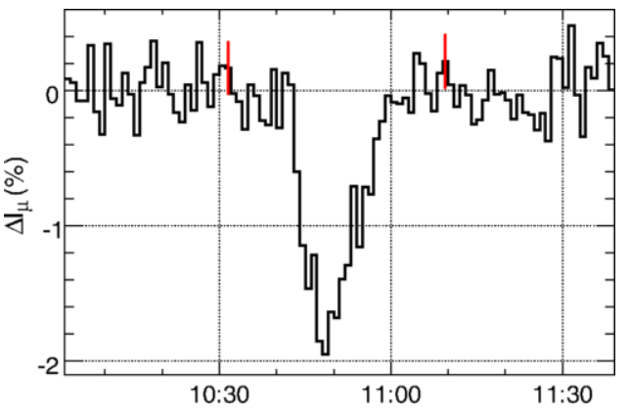
Cosmic Ray Flux Rate
Muon Flux Intensity over Time
Measurement of the Electrical Properties of a Thundercloud Through Muon Imaging by the GRAPES-3 Experiment
Notes:
This plot shows the muon flux rate over time during a thunderstorm. Researchers were able to use the muon count rate to deduce the charge of the storm cloud, knowing how high up it was and the energy of the muons involved; and while this is all interesting it has yet to involve astronomy. How can we change that?

Slide 33
Muon Telescope
Notes:
The muon telescope is a pretty nifty tool. Rather than using a single detector, you use two detectors and look for events that register on both detectors.

Slide 34
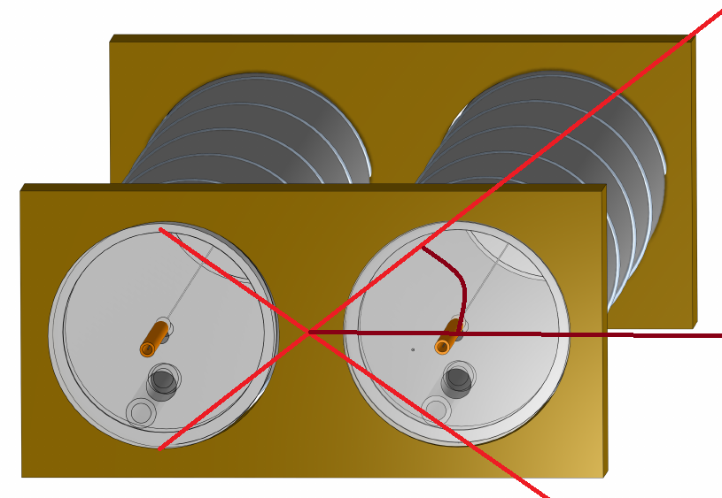
Muon Telescope
Two detectors placed side by side. In this picture, two muon detector tubes are positioned side by side to form an angle of detection. We could prescribe a focal length to the muon telescope by the distance from a tube to the midpoint of the telescope.
Notes:
This diagram shows two muon detector tubes side by side to make a muon telescope. When muons pass through both detectors at the same time, you know that the muon came from somewhere within the cone drawn on the diagram. We can prescribe a naive focal length to this telescope, as one half the total length of the detector. The further spread out the tubes are, the less coincident detections there will be and the slower the data acquisition will go. This tool is far more appropriate for astronomy!

Slide 35
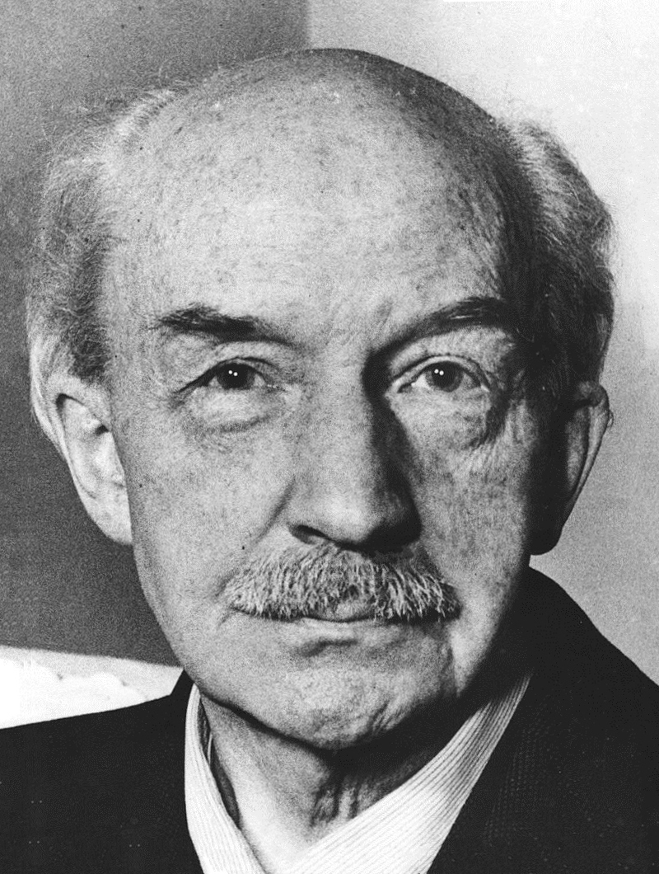
Coincidence Detector
Coincidence detectors looks at two signal inputs, and output a signal if both inputs are on at the same time. This is essentially a high speed AND gate, logic wise. Discovery of the coincidence circuit resulted in a Nobel Prize in Physics for Walther Bothe in 1954.
The sensitivity of a coincidence circuit can be ignored by
using software and setting an appropriate error time, 𝜟t.
Notes:
In old particle telescopes, the two tubes would be connected to their own amplifiers and shapers, then into a coincidence circuit. The discovery of the coincidence circuit was so groundbreaking, it resulted in a Nobel Prize. Fortunately for us, however, we live in the digital age and can simply write down the time a detection occurs with microsecond precision, and save the time and effort. Any number of detectors can be compared in this way to look for coincident detections.

Slide 36
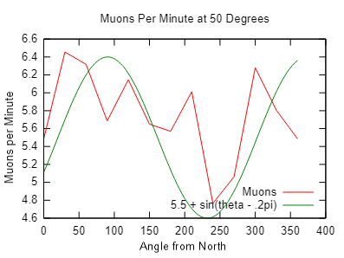
Muon Telescope Experiments
Notes:
This plot demonstrates the simple east-west effect. By taking 1 minute measurements of the coincidence events, we can see that there is some level of rate dependence on the muon telescope azimuth. This data was taken with my geiger tube detector.

Slide 37
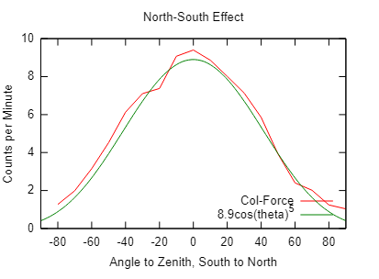
Muon Telescope Experiments
Notes:
This plot, made with the same muon telescope, shows that there is a clear dependence on the altitude angle of the telescope. When pointing straight up, the telescope measures many more coincident events than at any other angle; clear proof that the measured radiation is cosmic in origin. To a particle astronomer, this is equivalent to a blurry picture of M42; a solid beginner’s attempt.

Slide 38
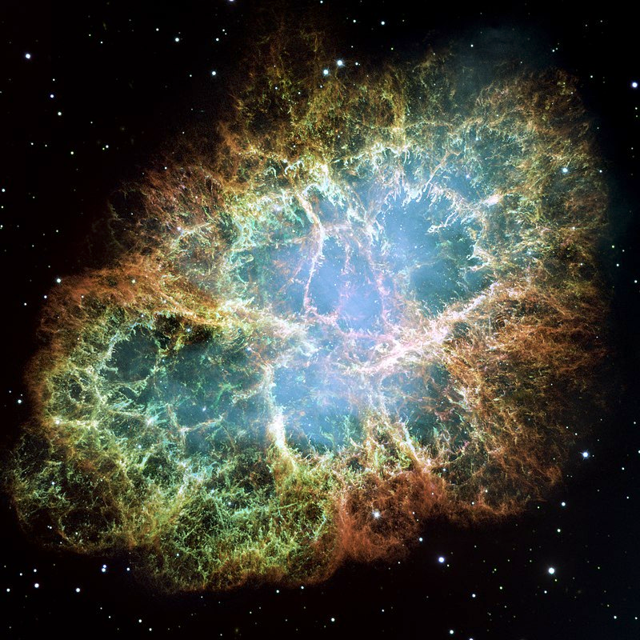
Muon Telescope Experiments
Supernova particle front detection
Blazar observation
Cave Mapping
By NASA, ESA, J. Hester and A. Loll (Arizona State University) - HubbleSite: gallery, release., Public Domain, https://commons.wikimedia.org/w/index.php?curid=516106
Notes:
There are more advanced observations to make. One is to observe the particle front of a supernova; a single telescope is able to detect the emergence of a supernova, and having several telescopes would allow observations to be narrowed down to a region of sky. Blazars, or accreting black holes with jets pointed toward Earth, have been found to emit cosmic rays within the last few years. A high-focal length particle telescope would be able to observe these features with disregard for background noise. Particle telescopes can also be used to map cavern systems, by taking readings in all directions from a low part in a cave; it is like having a flashlight that shines right through rock! Satellites can use particle telescopes to map out radiation bands around the planet, so as price of launch continues to decrease there is no reason amateurs wouldn’t be able to launch their equipment to orbit.

Slide 39
What is next?
Notes:
What other projects are there that can be done with this equipment? Can you go further than a single muon telescope?

Slide 40
Muon Detector Array?
Using mini computers, an array of small detectors can be arranged, observing large regions of sky.
Club Level Activity
Notes:
One project I would love to attempt is building a muon detector array. Rather than having a single telescope pointed at the sky, and array is able to detect cosmic ray direction and energy using numerous detectors. Every detector array built thus far has been by a larger institution, simply because of the associated price involved. With cheaper detectors available today than existed when these arrays were planned, it isn’t hard to imagine an amateur particle detector array in the near future.

Slide 41
Open Source Projects
Cosmic Watch Muon Detector
‘Muoscope’ Detector
INDI Particle Physics Drivers
Quarknet Classes
MIT OpenCourseWare
Notes:
And, I must say the future looks bright for amateur particle astronomy. These are some the open source projects I know about right now for amateur particle astronomers. My scintillator detector is based off of the Cosmic Watch muon detector, where everything you need to build and run a muon detector can be found. Many of the hard to find components, like scintillator, are cheaply available on Ebay specifically for this open source project. Last year, some of the guys and gals at CERN released a new muon telescope design to the public called the muoscope, for muography. I would like to try and use the INDI: particle physics to configure my future telescopes, that way the detector runs on the same software as all my other astronomy equipment can. For people looking for more information on particle astronomy without getting a four year degree, masters, and PhD, Fermilab offers free work guides on Quarknet.org, alongside full classes on statistics and instrumentation. MIT OpenCourseWare also has a number of free experiments, books, and guides for fledgling particle astronomers.

Slide 42
Thanks!
Notes:
Thanks for having me! I would be happy to answer any questions you have.

Slide 43
Extra Slides

Slide 44
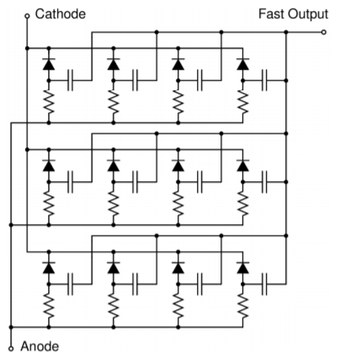
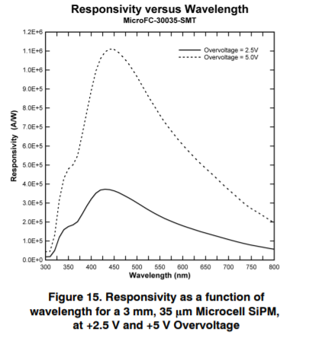
SiPM
Silicon Photomultiplier
Schematic and Pictures

